Slide 1
Vivekanand College, Kolhapur (Empowered Autonomous)
Name of the Subject: Fundamentals of Entrepreneurship
Name of the Topic: Micro Small and Medium Enterprises
Name of the Teacher: Mr. Satish Nishikant Chavan

Slide 3
INTRODUCTION OF MSME
The MSME sector constitutes an important part of Indian Economy. It is regarded as backbone of development and engine for economic Development. It plays a crucial role in employment generation. According to the report of NSS in 2015-16 there were around 633.8 L unincorporated non-agriculture enterprises in the country providing jobs to 11.10 Cr people out of which 360.42 L in manufacturing sector and remaining in service sector. Another importance of MSME’s is that they act as a supporting industry to many large Industries. Its role has increased in the mission of Make in India. Hence the role of MSME in Job creation and industrialization has become a boon to the country.

Slide 4
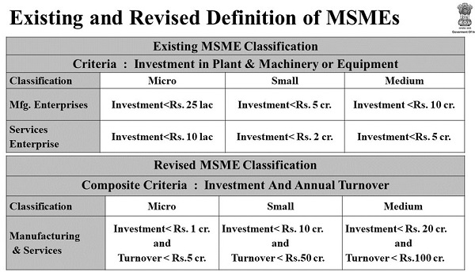
MSME CLASSIFICATION

Slide 5
IMPORTANCE OF MSME
1. Creates large amount of Employment
2. Help in export promotion
3. Helps in maintaining economic stability
4. Low – cost wages and overhead
5. Fair distribution of wealth.
6. Simple management structure.
7. Balanced regional development.
8. Use of local resources.
9. Capital mobilization
10. Stimulates Entrepreneurship Development.

Slide 6
Problems of MSME
Insufficiency of credit from banks
Tuff Competition
Low quality Infrastructure
Shortage of Raw Material
Problem of advance technology
Lack of marketing channel
Underutilization of the capacity
Problem of recovery
Initial obstacles
Institutional Obstacles.

Slide 7
Remedies
Equitable distribution of raw material
Provision of adequate finance
Marketing assistance
Industrial Education and training
Provisions of Infrastructural facility
Development of technology and methods of production

Slide 8
Steps in formation of Small Enterprises
Identification of business opportunity
Generation of Business Idea
Feasibility study
Preparation of business plan
Location
Clearance
Permits required
Licensing and Registration

