Slide 1
Unit -I Introduction to Data Science

Slide 2
Why Data Science now?
We have massive amounts of data about many aspects of our lives and, simultaneously, an abundance of inexpensive computing power.
Shopping, communicating, reading news, listening to music, searching for information, expressing our opinions—all this is being tracked online, as most people know.
It’s not just Internet data, though—it’s finance, the medical industry, pharmaceuticals, bioinformatics, social welfare, government, education, retail, and the list goes on.

Slide 3
the amount of data collected might be enough to be considered “big”
the data itself, often in real time, becomes the building blocks of data products

Slide 4
Datafication
In the May/June 2013 issue of Foreign Affairs, Kenneth Neil Cukier and Viktor Mayer-Schoenberger wrote an article called “The Rise of Big Data”.
In it they discuss the concept of datafication.
They define datafication as a process of “taking all aspects of life and turning them into data.”

Slide 5
“Google’s augmented-reality glasses datafy the gaze.
Twitter datafies stray thoughts
LinkedIn datafies professional networks
We are being datafied, or rather our actions are, and when we “like” someone or something online, we are intending to be datafied, or at least we should expect to be.

Slide 6
when we merely browse the Web, we are unintentionally, or at least passively, being datafied through cookies that we might or might not be aware of.
when we walk around in a store, or even on the street, we are being datafied in a completely unintentional way, via sensors, cameras, or Google glasses.

Slide 7
History and Current landscape of perspectives
Data science is new in some ways and not new in other ways.
Many would argue that statisticians have already been doing a lot of what today we consider data science.
On the other hand, we have an explosion of data in every sector, with data varying a great deal in its nature, format, size, and other aspects.

Slide 8
On Quora there’s a discussion from 2010 about “What is Data Science?” and here’s Metamarket CEO Mike Driscoll’s answer:
Data science, as it’s practiced, is a blend of Red-Bull-fueled hacking
and espresso-inspired statistics.
But data science is not merely hacking—because when hackers finish
debugging their Bash one-liners and Pig scripts, few of them care
about non-Euclidean distance metrics.
And data science is not merely statistics, because when statisticians
finish theorizing the perfect model, few could read a tab-delimited
file into R if their job depended on it.
Data science is the civil engineering of data. Its acolytes possess a
practical knowledge of tools and materials, coupled with a theoretical
understanding of what’s possible.

Slide 9
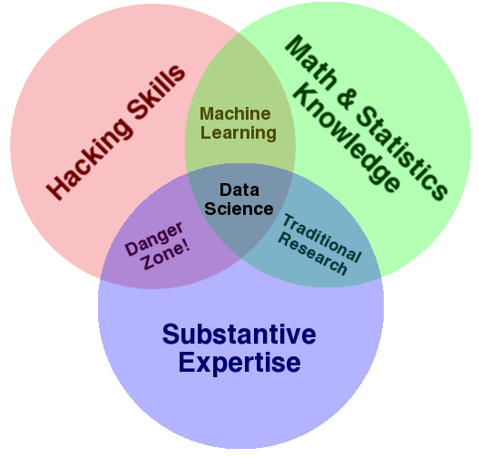
Drew Conway’s Venn diagram of data science

Slide 10
People mean when they say “data science”: it is fundamentally an interdisciplinary subject. Data science comprises three distinct and overlapping areas:
the skills of a statistician who knows how to model and summarize datasets (which are growing ever larger);
the skills of a computer scientist who can design and use algorithms to efficiently store, process, and visualize this data;
the domain expertise—what we might think of as “classical” training in a subject—necessary both to formulate the right questions and to put their answers in context.

Slide 11
Driscoll also mentions the sexy skills of data geeks from Nathan Yau’s 2009 post, “Rise of the Data Scientist”, which include:
# Statistics (traditional analysis you’re used to thinking about)
# Data munging (parsing, scraping, and formatting data)
# Visualization (graphs, tools, etc.)

Slide 12
D.J. Patil described how he and Jeff Hammerbacher—then at LinkedIn and Facebook, respectively—coined the term “data scientist” in 2008. So that is when “data scientist” emerged as a job title. (Wikipedia finally gained an entry on data science in 2012.)

Slide 13
In 2001, William Cleveland wrote a position paper about data science called “Data Science: An action plan to expand the field of statistics.”

