Slide 1
Unit -I Introduction to Data Science

Slide 2
We are drenched in data through many ways of life, and so many of our problems can be solved using large amounts of data existing at personal and societal levels.
Familiar with terms
Data
Data sharing
Data storing/warehousing (databases/warehouses)

Slide 3
Data All Around
Lots of data is being collected and warehoused (stored)
Web data, e-commerce
Financial transactions, bank/credit transactions
Online trading and purchasing
Social Network

Slide 4
How Much Data Do We have?
Google processes 20 PB a day
Facebook has 60 TB of daily logs as it has
Daily 1.84 Billion Users
Facebook generates 4 PB of data/day.
eBay has 6.5 PB of user data + 50 TB/day
Twitter generates more than 12 TB data/day

Slide 5
General Stats: Per Minute Ratings
Here are some of the per minute ratings for various social networks:
Snapchat: Over 527,760 photos shared by users
LinkedIn: Over 120 professionals join the network
YouTube: 4,146,600 videos watched
Twitter: 456,000 tweets sent or created
Instagram: 46,740 photos uploaded
Netflix: 69,444 hours of video watched
Giphy: 694,444 GIFs served
Tumblr: 74,220 posts published
Skype: 154,200 calls made by user

Slide 6
Big Data
Big Data is any data that is expensive to manage and hard to extract value from
Volume
The size of the data
Velocity
The latency of data processing relative to the growing demand for interactivity
Variety and Complexity
the diversity of sources, formats, quality, structures.

Slide 7
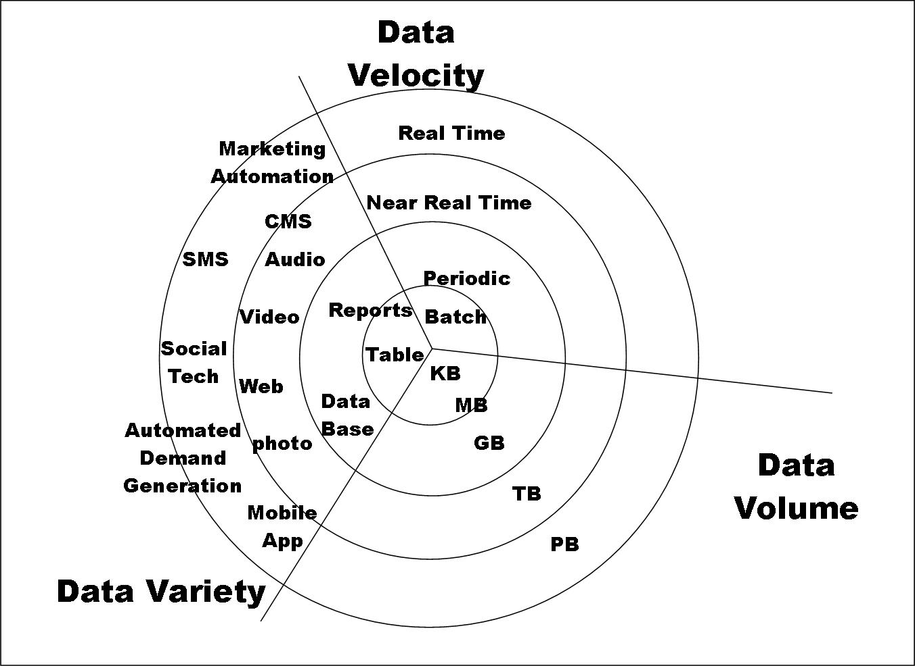
Big Data

Slide 8
Types of Data We Have
Relational Data (Tables/Transaction/Legacy Data)
Text Data (Web)
Semi-structured Data (XML)
Graph Data
Social Network, Semantic Web, …
Streaming Data
NL
Videos, Images
Electronic Data( Sensor Data, RFID ….)

