Slide 1
Unit-I Introduction to Java and Java Fundamentals

Slide 2
Lecture Contents
History of Java
Features of Java

Slide 3
History of Java
History of Java starts with green team.
In 1990, Sun Microsystems funded an internal research project “Green” to develop a language for digital devices.
James Gosling, Mike Sheridan and Patrick Naughton initiated this project in 1991 and resulted in a programming language ‘Greentalk’ which then renamed as ‘Oak’.
There was already a programming language called ‘Oak’ so green team again renamed it with ‘Java’ in 1995, the name taken from Java Coffee.
Java was originally designed for small embedded systems in electronic application like set top boxes, TVs, VCRs, Toasters, Microvaves, Washing Machines etc.

Slide 4
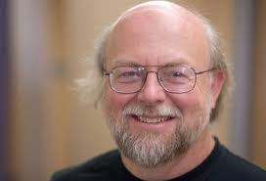
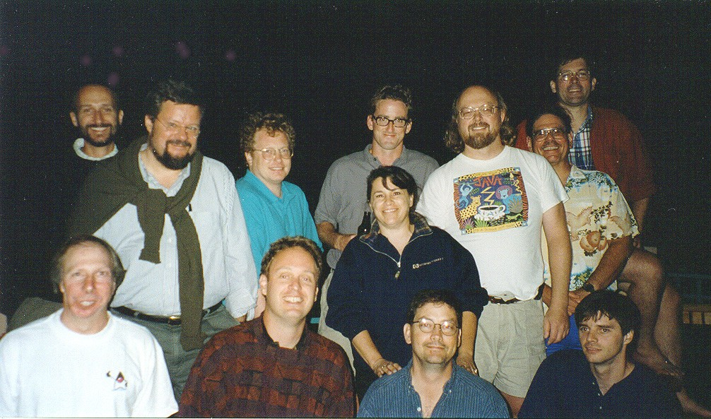
James Gosling
Mike Sheridan
Patrick Naughton
Green Team

Slide 5
So Java originally developed by James Gosling and team at Sun Microsystems which is now a subsidiary (2010) of Oracle Corporation.
Java is general purpose and object oriented programming language.
The extension of java program file is .java
First Java version was released in 1995 with name JDK Alpha and Beta.
In very next year, 1996 , JDK 1.0 released and since then number of Java versions have been released.
JDK 14 i.e. Java SE 14 has released in March ,2020.

Slide 6
Features of Java
Familiar, Simple
Object-Oriented
Compiled and Interpreted
Platform-Independent
Portable
Architecture Neutral
Robust
Secure
High Performance
Multithreaded
Distributed
Dynamic and Extensible

Slide 7
Familiar, Simple
Java is very easy to learn, and its syntax is simple, clean and easy to understand.
Java syntax is based on C and C++
Java has removed many complicated , confusing , ambiguous, and rarely-used features, for example, explicit pointers, operator overloading, etc.
Object Oriented
Object-oriented programming (OOPs) is a methodology that simplifies software development and maintenance by providing some rules and concepts.
In Java, everything is an object, which has some data and behavior.
All Java program code resides in class/classes and handled using objects.
Java has extensive set of predefined classes (utilities, I/O, GUI, Networking, WWW, HTML etc. )and these are arranged in packages.

Slide 8
Compiled and Interpreted
Java is a two stage system. In first stage, Java program is compiled i.e. the java program is translated into the byte code. For compilation javac compiler is used.
The byte code is intermediate code, it is not a low level code so it is some what in readable form. This code is not understandable to machine. So to convert byte code to machine instructions and to execute this code, java interpreter is used at second stage.

Slide 9
Programmer
Hardware and
Operating System
Source Code
Byte Code
Text Editor
Compiler
Interpreter
.java file
.class file
Notepad, emacs,vi
javac
java/
appletviewer

Slide 10
Platform Independent
A platform is the environment where program runs. It can be software platform or hardware platform
Java provides software platform to execute java programs.
Java programs can be moved from anywhere to anywhere i.e. Write Once and Run Anywhere (WORA)
The byte code generated by java compiler (javac) is platform independent
It means, we can take this byte code i.e. .class file and execute it in any platform using java interpreter (java).

Slide 11
JAVA COMPILER
(translator)
JAVA BYTE CODE
(same for all platforms)
JAVA INTERPRETER
(one for each different system)
Windows
Macintosh
Solaris
Linux

Slide 12
Portable
Porting the java program or system to any new platform involves the only existence of an interpreter.
The interpreter will figure out what the equivalent machine dependent code to run
Byte code generated at one platform can be implemented on any machine.

Slide 13
Architecture Neutral
In Java, size of primitive data types is machine independent.
In C programming, int data type occupies 2 bytes of memory for 32-bit architecture and 4 bytes of memory for 64-bit architecture.
However, it occupies 4 bytes of memory for both 32 and 64-bit architectures in Java.

Slide 14
Robust
Java is strong in memory management.
There is automatic garbage collection which get rid of objects which are not being used by a Java application anymore.
There are exception handling to handle the exceptions and the type checking mechanism make Java more robust.

Slide 15
Secure
Absence of pointer concept in Java ensures that program cannot access memory location without prior permissions.
Java program always runs in the Java Runtime Environment so almost no interaction takes place with native operating system.
High Performance
Performance of Java is impressive because of byte code and feature like multithreading.
But little but slower as compared to C and C++.

Slide 16
Multithreaded
We can write Java programs that deal with many tasks at once by defining multiple threads.
A thread is like a separate program, executing concurrently.
The main advantage of multi-threading is that it doesn't occupy memory for each thread.
It is designed as distributed language for creating network applications.
RMI and EJB are used to create distributed applications.
Java applications can access remote objects or can communicate to many locations on the network.
Distributed

Slide 17
Dynamic and Extensible
Java is capable of loading classes on demand.
Java programs support functions written in other languages like C and C++.
It enables programmers to use efficient functions available from other languages

