Slide 1
Unit-I Introduction to Java and Java Fundamentals

Slide 2
Lecture Contents
Java Environment
Java Tools and IDEs

Slide 3
Java Environment
* Java Virtual Machine (JVM)
JVM (Java Virtual Machine) is an abstract machine that enables our computer to run a Java program.
It is set of instructions which uses memory and translate a byte code generated by java compiler into native machine code.
The byte code generated by java compiler is JVM understandable code
Java is a platform-independent language. It's because when we write Java code, it's ultimately written for JVM but not for our physical machine (computer).

Slide 4
* Java Runtime Environment (JRE)
JRE (Java Runtime Environment) is a software package that provides Java class libraries, Java Virtual Machine (JVM), and other components that are required to run Java applications.
It is also known as software implementation of JVM
JRE performs following main task.
Loads the class :- Class Loader loads the class file for execution
Verifies the byte code: Byte code verifier verifies the byte code
(security problems, tampering)
JIT compilation: To improve the performance of execution Just in Time compiler is used.

Slide 6
* Java Development Kit (JDK)
JDK (Java Development Kit) is a software development kit required to develop applications in Java.
When we download JDK, JRE is also downloaded with it.
JDK also contains a number of development tools (compiler, JavaDoc, Java Debugger, etc).

Slide 7
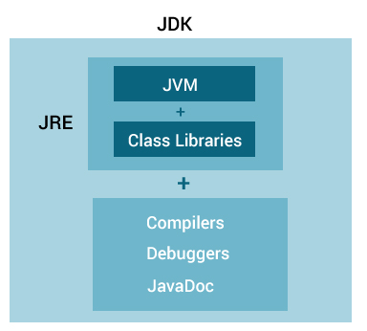
* Java Environment

Slide 8
Java Platform
The combination of JRE and other libraries is known as Java Platform.
Libraries are related to GUI, I/O, event handling, file handling, networking etc.
It was renamed to Java 2 in 1998.
Java comes in three editions
Java Standard Edition (used for stand alone application, client-side applications, applets etc.)
Java Enterprise Edition(client-server applications, servlets, distributed applications etc.)
Java Micro Edition(use for mobile applications[midlets], wireless applications)

Slide 9
Download Java from?
www.oracle.com/java/technologies/javase-downloads.html
Java SE 15 is latest release of Java SE platform
We can download it for windows i.e. Java SE DK 15
(Windows x64 Installer, Windows x64 Compressed Archive)

Slide 10
Java Tools
Tool Name
Used for
javac
java
javadoc
It is java compiler. Used to compile java program which converts it into byte code.
It is java interpreter, also known as application launcher. Used to run java program which converts and executes java code.
It creates HTML help file from source code

Slide 11
Java Tools
Tool Name
Used for
jdb
appletviewer
It is java debugger. Used to debug java program.
It is applet launcher. Used to run applets.

Slide 12
Java IDEs
An Integrated Development Environment(IDE) is a software application that provides facilities for software development.
It normally consists editor, compiler, interpreter, debugging tool, build tool, intelligent code completion etc.
IntelliJ IDEA, Eclipse, NetBeans, Jbuilder, Jcreator are some of the the most powerful, popular, and fully-featured Integrated Development Environments (IDE) for Java Developers.

