Slide 1
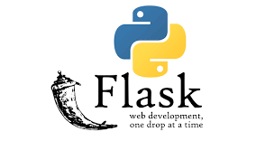

Slide 2
Contents …..
What is Web FrameWork …
What is Flask..
Components of Flask…
Features of Flask..

Slide 3
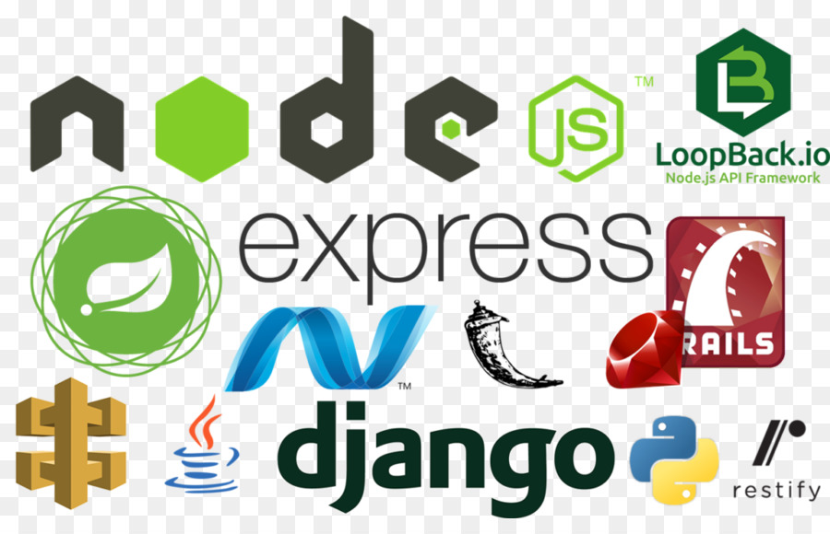
What is Web Framework?
Web Application Framework or simply Web Framework
represents a collection of libraries and modules
enables a web application developer to write applications without having to bother about low-level details such as protocols, thread management

Slide 4
What is Flask?
Flask framework is used to build a website
Flask is a web application framework written in Python.
It is developed by Armin Ronacher
It is a tool that helps create sites quicker.
Flask makes development faster by offering code for all sorts of processes like database interaction or file activity.

Slide 6
Components
Werkzeug : is a utility library for the PYTHON Programmg Language , in other words a toolkit for Web Server Gateway Interface (WSGI) applications, and is licensed under a BSD License. Werkzeug can realize software objects for request, response, and utility functions. It can be used to build a custom software framework software framework on top of it and supports Python 2.7 and 3.5 and later.

Slide 7
Jinja
Jinja, by Ronacher, is a template engined for the Python programming language and is licensed under a BSD ( Berkeley Software Distribution ) License.
Similar to the Django Web Framework, it handles templates in a sandbox.

Slide 8
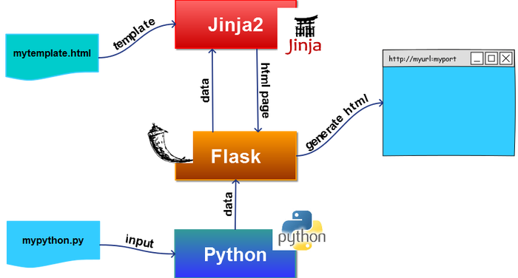

Slide 9
Features of Flask
A development server and debugger (sanity-friendly)
Unicode support ( Latin language-friendly )
WSGI compliance (uWsgi-friendly)
A unit-test client client (code with quality)
URL routing (it brings tears to my eyes, it's so beautiful!)
Request dispatching
Secure cookies
Sessions
Jinja2 templates (tags, filters, macros, and more)

Slide 10
Installation of Flask ……….

