Slide 1
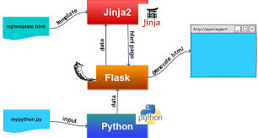
Jinja Template Engine
What Template Engines do ?
Loading Templates
Templates Variable

Slide 2
What is Jinja 2?
Jinja2 is a modern day templating language for Python developers. It was made after Django’s template. It is used to create HTML, XML or other markup formats that are returned to the user via an HTTP request.
How To Get Jinja 2
pip install jinja2easy_install jinja2
Rendering Pages in Flask using Jinja

Slide 3
Why do we need Jinja 2?
Sandboxed Execution: It provides a protected framework for automation of testing programs, whose behaviour is unknown and must be investigated.
HTML Escaping: Jinja 2 has a powerful automatic HTML Escaping, which helps preventing Cross-site Scripting (XSS Attack). There are special characters like >,<,&, etc. which carry special meanings in the templates. So, if you want to use them as regular text in your documents then, replace them with entities. Not doing so might lead to XSS-Attack.
Template Inheritance: This is the most important feature, which I will expand on to later in the post

Slide 4
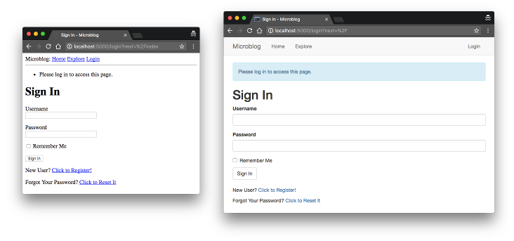

Slide 5
Simple Example
{{name}} had a little {{animal}}.
If name=“Mary” and animal=“Lamb”
Would be
Mary had a little Lamb

Slide 6
Python Script
Outputs
from flask import Flask
app = Flask(__name__)
@app.route('/')
def home():
return "Hello"
http://127.0.0.1:5000/
Hello
Python Script
Outputs
from flask import Flask
app = Flask(__name__)
@app.route('/<name>')
def hello(name):
return '<h1>Hello %s</h1>' %name
http://127.0.0.1:5000/Radhika
Hello Radhika

Slide 7
from flask import Flask, render_template
app = Flask(__name__)
@app.route('/')
def hello():
return render_template('thirteen.html')
<html>
<body>
<h1>Hello !</h1>
</body>
</html>
http://127.0.0.1:5000/
Hello !
from flask import Flask, render_template
app = Flask(__name__)
@app.route('/<user>')
def hello(user):
return render_template('twelve.html', name = user)
<html>
<body>
<h1>Hello {{ name }}!</h1>
</body>
</html>
http://127.0.0.1:5000/Radhika
Hello Radhika!

Slide 8
from flask import Flask,render_template
app=Flask(__name__)
@app.route('/<login>/<password>')
def home(login,password):
return render_template("login.html",loginname=login,passwd=password)
html>
<body>
<h1>Login Name {{loginname}}!</h1>
<h2>Password {{passwd}}
</body>
</html>
http://127.0.0.1:5000/abc/abc@123
Login Name abc!
Password abc@123

Slide 9
Continue to Coding…

