Slide 1
Topic: Basic concepts-II
DSE1006A- Python
Ms. Rajashree Patil
Assistant Professor,
Department of Computer Science,
Vivekanand College (Autonomous), Kolhapur (MS) India

Slide 2
Constant : Data values that stay the same every time a program is executed are known as constants. Constants are not expected to change.
Variables
Variables are data values that can change when the user is asked a question, for example, their age. Variables may change during program execution.
A variable is a memory location. It has a name that is associated with that location. The memory location is used to hold data. The key difference when comparing a constant to a variable is that the value associated with a variable name may change during program execution. For example ‘marks ' would need to be variable to change throughout a year.
Marks
95

Slide 3
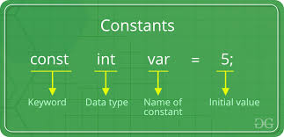
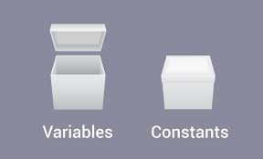
Number = 10
Height = 5.6
Boolean = ‘T’
Name= “abc”

Slide 4
Algorithm to add 2 nos. 100 & 200
100
+
200
=
300
Step 1: Start
Step 2: x=100
Step 3: y=200
Step 4: z=x+y
Step 5: Print z
x
y
?

Slide 5
Algorithm to add any 2 nos.
?
+
?
=
?
Step 1: Start
Step 2: Input x
Step 3: Input y
Step 4: z=x+y
Step 5: Print z
Step 6: End
x
y
?
100
200
300

Slide 6
Variables convention Rules :
Name your variables based on the terms of the subject area, so that the variable name clearly describes its purpose.
2. Create variable names by deleting spaces that separate the words. Capitalize each word in the name, including prepositions and pronouns that consist of a single letter.
Do not begin variable names with an underscore.
Do not use variable names that consist of a single character. Short variable names are only allowed for loop counters.
5. Name variables that describe binary states ("true" or "false") after the state that matches the "true" value.
Eg. Number 1 - Not Correct Number1 - Correct
#num - Incorrect

Slide 7
Algorithm to add 4 nos. 10,20,30,40
Algorithm to add 4 nos. inputted by user
Step 1: Start
Step 2: no1=10
Step 3: no2=20
Step 4: no3=30
Step 5: no4=40
Step 6: ans=no1+no2+no3+no4
Step 7: Print ans
Step 7: End
Step 1: Start
Step 2: Input no1,no2,no3,no4
Step 3: ans=no1+no2+no3+no4
Step 4: Print ans
Step 5: End
If Input 10,20,30,40
Output 100
If Input 100,200,300,400
Output 1000

