Slide 1
Topic: Physical Layer (Cabling)
DSE1006E1- Computer Network
Dr. V. B. Waghmare
Assistant Professor & Head,
Department of Computer Science,
Vivekanand College (Autonomous), Kolhapur (MS) India

Slide 2
Content
Introduction
Twisted Pair
Coaxial Cable
Optical Fibre

Slide 3
Introduction
Cable is the medium through which information usually moves from one network device to another.
The type of cable chosen for a network is related to the network's topology, protocol, and size.
The following are the types of cables used in networks.
1. Twisted Pair Cable
2. Coaxial Cable
3. Fiber Optic Cable

Slide 4
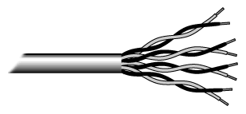
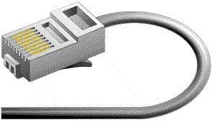
Twisted Pair Cable
Twisted pair cabling comes in two varieties: shielded and unshielded. Unshielded twisted pair (UTP) is the most popular and is generally the best option for school networks
Fig. Unshielded twisted pair
The standard connector for unshielded twisted pair cabling is an RJ-45 connector. This is a plastic connector that looks like a large telephone-style connector. A slot allows the RJ-45 to be inserted only one way. RJ stands for Registered Jack
Fig. RJ-45 connector

Slide 5
Coaxial Cable
Coaxial cabling has a single copper conductor at its center. A plastic layer provides insulation between the center conductor and a braided metal shield. The metal shield helps to block any outside interference from fluorescent lights, motors, and other computers.
Fig. Coaxial cable
Fig. BNC connector
The most common type of connector used with coaxial cables is the Bayone-Neill-Concelman (BNC) connector.
Although coaxial cabling is difficult to install, it is highly resistant to signal interference. One disadvantage of thick coaxial is that it does not bend easily and is difficult to install.

Slide 6
Fiber Optic Cable
Fiber optic cabling consists of a center glass core surrounded by several layers of protective materials. It transmits light rather than electronic signals eliminating the problem of electrical interference. This makes it ideal for certain environments that contain a large amount of electrical interference. It has also made it the standard for connecting networks between buildings, due to its immunity to the effects of moisture and lighting.
The center core of fiber cables is made from glass or plastic fibers. A plastic coating then cushions the fiber center, and kevlar fibers help to strengthen the cables and prevent breakage. The outer insulating jacket made of teflon or PVC.
Fig. Fiber optic cable

