Slide 1
Topic: Computer Network Components
DSE1006E1- Computer Network
Dr. V. B. Waghmare
Assistant Professor & Head,
Department of Computer Science,
Vivekanand College (Autonomous), Kolhapur (MS) India

Slide 2
Content
Computer network components
NIC (Network Interface Card)
Transmission Media

Slide 3
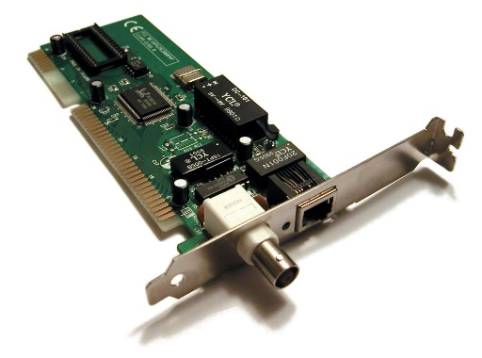
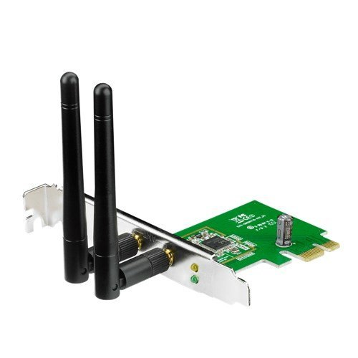
Introduction
NIC, switch, cable, hub, router, and modem.
NIC (Network Interface Card)
Wired NIC
Wireless NIC

Slide 4
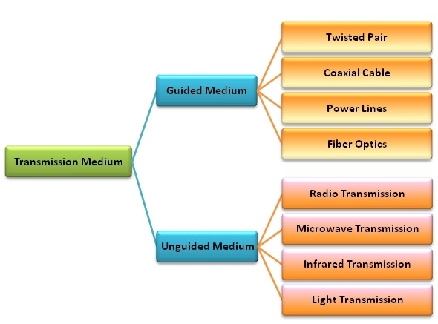
Transmission Media
Guided Transmission Medium
Unguided Transmission Medium

Slide 5
Guided Transmission Medium
Guided transmission media are also called bounded media or wired media
The most popular guided media are −
Twisted pair cable
Coaxial cable
Power lines
Fiber optics

Slide 6
Unguided Transmission Medium
Unguided transmission media are also called wireless media.
The commonly used unguided transmissions are −
• Radio transmission
• Microwave transmission
• Infrared transmission
• Light transmission

