Slide 1
Topic: Network Devices
DSE1006E1- Computer Network
Dr. V. B. Waghmare
Assistant Professor & Head,
Department of Computer Science,
Vivekanand College (Autonomous), Kolhapur (MS) India

Slide 2
Content
Hub
Repeater
Switch
Router
Bridge
Gateway

Slide 3
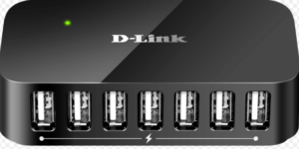
Hub
A hub is a device for connecting multiple Ethernet devices and making them act as a single network segment.
Types of Hub −
Active Hub
Passive Hub
Intelligent Hub

Slide 4
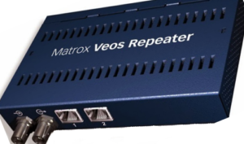
Repeater
A Repeater connects two segments of a network cable.
Sometimes it regenerates the signals to proper amplitudes and sends them to the other segment.

Slide 5
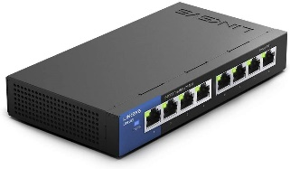
Switch
A Switch can check the errors before forwarding the data, which makes it more efficient and improves its performance. A switch is the better version of a hub. It is a multi-port bridge device.

Slide 6
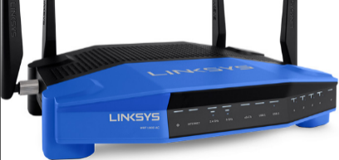
Router
Routers are small physical devices that operate at the network layer to join multiple networks together.
Two types of routers −
Static routers – Static routers are configured manually
Dynamic routers – Dynamic routers use adaptive routing

Slide 7
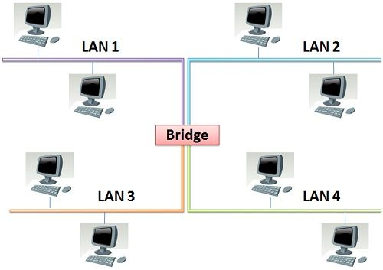
Bridge
It can read only the outmost hardware address of the packet but cannot read the IP address. It reads the outmost section of the data packet to tell where the message is going. It reduces the traffic on other network segments. It does not send all the packets. So, a bridge can be programmed to reject packets from a particular network.

Slide 8
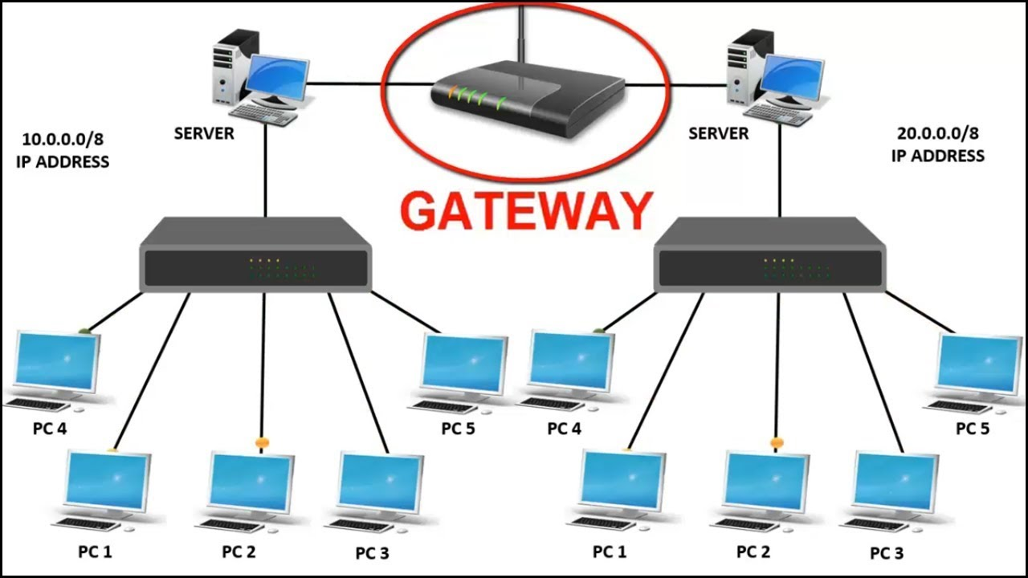
Gateway
A gateway is an internetworking capable of joining together two networks that use different base protocols.
A network gateway can be implemented completely in software, hardware, or a combination of both, depending on the types of protocols they support.
A network gateway can operate at any level of the OSI model.

