Slide 1
Topic: Framing in Data Link Layer
DSE1006E1- Computer Network
Dr. V. B. Waghmare
Assistant Professor & Head,
Department of Computer Science,
Vivekanand College (Autonomous), Kolhapur (MS) India

Slide 2
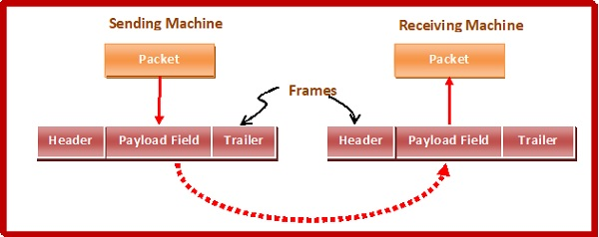
Framing in Data Link Layer
Synchronized transmission of bits from the source to the destination.
The data link layer packs these bits into frames.
Data-link layer takes the packets from the Network Layer and encapsulates them into frames. If the frame size becomes too large, then the packet may be divided into small sized frames.

Slide 3
Parts of Frame
Frame Header − It contains the source and the destination addresses of the frame.
Payload field − It contains the message to be delivered.
Trailer − It contains the error detection and error correction bits.
Flag − It marks the beginning and end of the frame.

Slide 4
Flow Control
Flow Control mainly coordinates with the amount of data that can be sent before receiving an acknowledgment from the receiver and it is one of the major duties of the data link layer.
For most of the protocols, flow control is a set of procedures that mainly tells the sender how much data the sender can send before it must wait for an acknowledgment from the receiver.

Slide 5
Error Control
Error Control contains both error detection and error correction. It mainly allows the receiver to inform the sender about any damaged or lost frames during the transmission and then it coordinates with the retransmission of those frames by the sender.
The term Error control in the data link layer mainly refers to the methods of error detection and retransmission.

