Slide 1
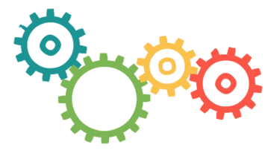
Topic: Transport Layer Services
DSE1006E1- Computer Network
Dr. V. B. Waghmare
Assistant Professor & Head,
Department of Computer Science,
Vivekanand College (Autonomous), Kolhapur (MS) India

Slide 2
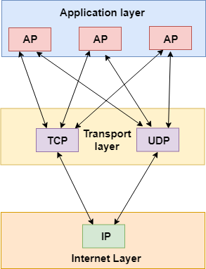
Transport Layer
The main role of the transport layer is to provide the communication services directly to the application processes running on different hosts.
The transport layer provides a logical communication between application processes running on different hosts.

Slide 3
The services provided by the transport layer protocols
End-to-end delivery
Addressing
Reliable delivery
Flow control
Multiplexing

Slide 4
User Datagram Protocol (UDP)
UDP stands for User Datagram Protocol.
UDP is a simple protocol and it provides nonsequenced transport functionality.
UDP is a connectionless protocol.
This type of protocol is used when reliability and security are less important than speed and size.
UDP is an end-to-end transport level protocol that adds transport-level addresses, checksum error control, and length information to the data from the upper layer.
The packet produced by the UDP protocol is known as a user datagram.

Slide 5
Transmission Control Protocol (TCP)
TCP stands for Transmission Control Protocol.
It provides full transport layer services to applications.
It is a connection-oriented protocol means the connection established between both the ends of the transmission. For creating the connection, TCP generates a virtual circuit between sender and receiver for the duration of a transmission.

