Slide 1
Topic: Application Layer
DSE1006E1- Computer Network
Dr. V. B. Waghmare
Assistant Professor & Head,
Department of Computer Science,
Vivekanand College (Autonomous), Kolhapur (MS) India

Slide 2
Application Layer
The Application layer includes the following functions:
Identifying communication partners
Determining resource availability
Synchronizing communication
Services provided by Application Layers:
Network Virtual terminal
File Transfer, Access, and Management (FTAM)
Addressing
Mail Services
Directory Services

Slide 3
Application Layer
Domain Name System (DNS):
Naming database in which internet domain names are located and translated into Internet Protocol (IP) addresses.
The domain name system maps the name people use to locate a website to the IP address that a computer uses to locate that website.
For example, if someone types "example.com" into a web browser, a server behind the scenes maps that name to the corresponding IP address. An IP address is similar in structure to 203.0.113.72.
Web browsing and most other internet activities rely on DNS to quickly provide the information necessary to connect users to remote hosts.
DNS servers convert URLs and domain names into IP addresses that computers can understand and use. They translate what a user types into a browser into something the machine can use to find a webpage. This process of translation and lookup is called DNS resolution.

Slide 4
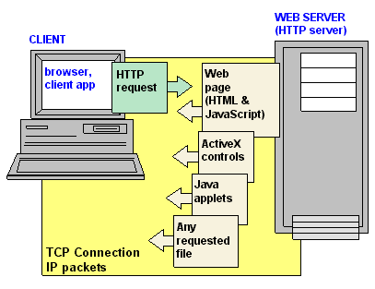
Application Layer
HyperText Transfer Protocol (HTTP)
The communications protocol used to connect to Web servers on the Internet or on a local network (intranet).
The primary function of HTTP is to establish a connection with the server and send HTML pages back to the user's browser.
Addresses of websites begin with an http:// prefix; however, Web browsers typically default to the HTTP protocol. For example, typing www.yahoo.com is the same as typing http://www.yahoo.com. In fact, only yahoo.com has to be typed in. The browser adds the rest.

Slide 5
Application Layer
World Wide Web (WWW)
which is also known as a Web, is a collection of websites or web pages stored in web servers and connected to local computers through the internet.
These websites contain text pages, digital images, audios, videos, etc.
A web page is given an online address called a Uniform Resource Locator (URL). A particular collection of web pages that belong to a specific URL is called a website, e.g., www.facebook.com, www.google.com, etc. So, the World Wide Web is like a huge electronic book whose pages are stored on multiple servers across the world.
Small websites store all of their WebPages on a single server, but big websites or organizations place their WebPages on different servers in different countries so that when users of a country search their site they could get the information quickly from the nearest server.

Slide 6
Application Layer
Telnet: is an application protocol used on the Internet or local area network to provide a bidirectional interactive text-oriented communication facility using a virtual terminal connection. User data is interspersed in-band with Telnet control information in an 8-bit byte oriented data connection over the Transmission Control Protocol (TCP).
Simple Mail Transfer Protocol (SMTP): is an internet standard communication protocol for electronic mail transmission. Mail servers and other message transfer agents use SMTP to send and receive mail messages. User-level email clients typically use SMTP only for sending messages to a mail server for relaying, and typically submit outgoing email to the mail server
File Transfer Protocol (FTP): is a standard communication protocol used for the transfer of computer files from a server to a client on a computer network. FTP is built on a client–server model architecture using separate control and data connections between the client and the server.

