Slide 1
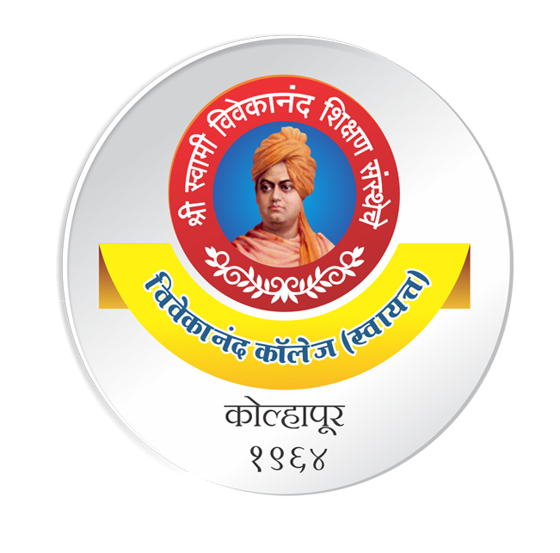
Topic: Directory Structure
DSE1006D – Operating System
Dr. V. B. Waghmare
Assistant Professor & Head,
Department of Computer Science,
Vivekanand College (Autonomous), Kolhapur (MS) India

Slide 2
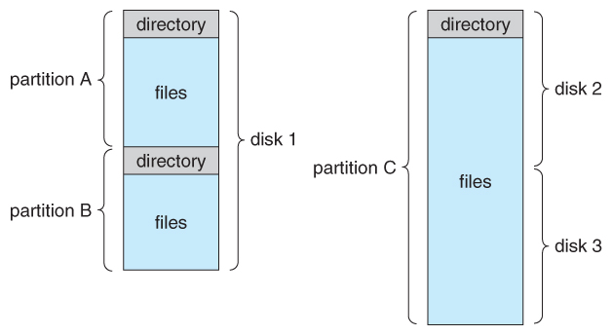
Storage Structure
A physical disk can be broken up into multiple partitions, slices, or mini-disks, each of which becomes a virtual disk and can have its own filesystem or multiple physical disks can be combined into one volume, i.e. a larger virtual disk, with its own filesystem spanning the physical disks.
Figure - A typical file-system organization.

Slide 3
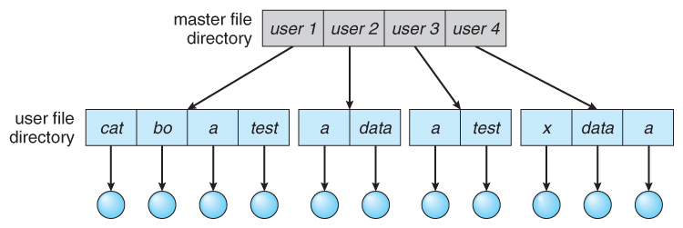
Storage Structure (cont..)
Single-Level Directory
Simple to implement, but each file must have a unique name.
Two Level Directory

Slide 4
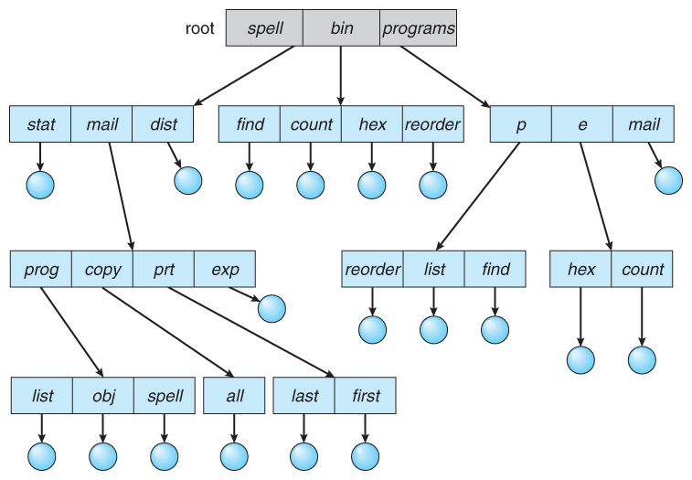
Storage Structure (cont..)
Tree Structure Directories

