Slide 1
Topic: File System Mounting
DSE1006D – Operating System
Dr. V. B. Waghmare
Assistant Professor & Head,
Department of Computer Science,
Vivekanand College (Autonomous), Kolhapur (MS) India

Slide 2
File System Mounting
Combine multiple file systems into one large tree structure.
The mount command is given a filesystem to mount and a mount point ( directory )
Once a file system is mounted onto a mount point, any further references to that directory actually refer to the root of the mounted file system.
Filesystems can only be mounted by root, unless root has previously configured certain filesystems to be mountable onto certain pre-determined mount points. We can run the mount command to see what filesystems are currently mounted.

Slide 3
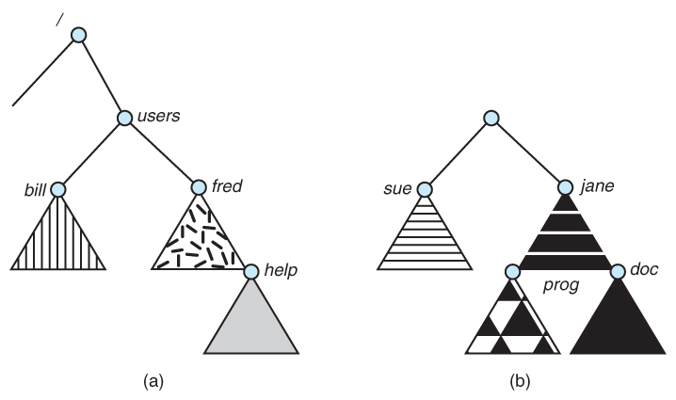
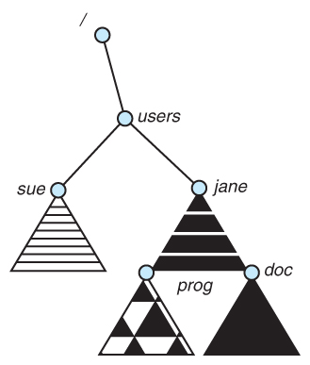
File System Mounting (cont..)
Figure - File system. (a) Existing system. (b) Unmounted volume.
Figure - Mount point

Slide 4
File System Mounting (cont..)
The traditional Windows OS runs an extended two-tier directory structure, where the first tier of the structure separates volumes by drive letters and a tree structure is implemented below that level.
Macintosh runs a similar system, where each new volume that is found is automatically mounted and added to the desktop when it is found.
More recent Windows systems allow filesystems to be mounted to any directory in the filesystem, much like UNIX.

