Slide 1
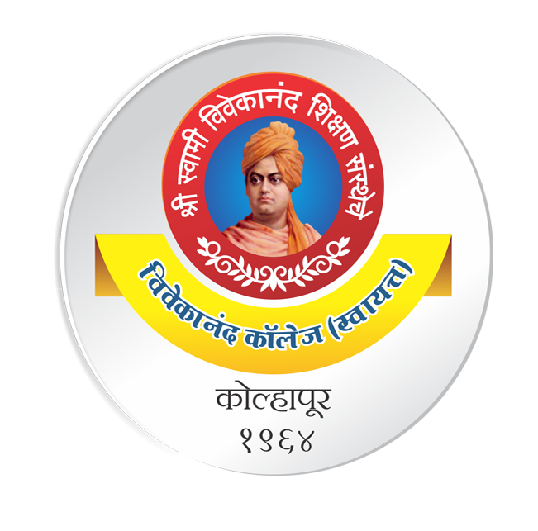
Topic: File Sharing
DSE1006D – Operating System
Dr. V. B. Waghmare
Assistant Professor & Head,
Department of Computer Science,
Vivekanand College (Autonomous), Kolhapur (MS) India

Slide 2
File Sharing
Multiple Users
On a multi-user system, more information needs to be stored for each file:
The owner ( user ) who owns the file, and who can control its access.
The group of other user IDs that may have some special access to the file.
What access rights are afforded to the owner ( User ), the Group, and to the rest of the world ( Others )
Some systems have more complicated access control, allowing or denying specific accesses to specifically named users or groups.

Slide 3
File Sharing (cont..)
Remote File Systems
The advent of the Internet introduces issues for accessing files stored on remote computers
ftp method. Ftp can be either account and password controlled, or anonymous, not requiring any user name or password.
Various forms of distributed file systems allow remote file systems to be mounted onto a local directory structure and accessed using normal file access commands.
The WWW has made it easy once again to access files on remote systems without mounting their filesystems.

Slide 4
File Sharing (cont..)
The Client-Server Model
• When one computer system remotely mounts a filesystem that is physically located on another system, the system which physically owns the files acts as a server and the system which mounts them is the client.
• User IDs and group IDs must be consistent across both systems for the system to work properly. ( i.e. this is most applicable across multiple computers managed by the same organization, shared by a common group of users. )
• The same computer can be both a client and a server. ( E.g. cross-linked file systems. )

