Slide 1
AERATION AND AGITATION.
  Miss. Tejaswini Shivaji Vagavekar.
Assistant Professor .
Department of Biotechnology (Entire)
Vivekanand College, Kolhapur

Slide 2
Primary Use.
Aeration is to provide microorganism in submerged culture with sufficient oxygen for metabolic requirements.
Agitation ensures that a uniform suspension of microbial cells is achieved in a homogenous nutrient medium.
Aeration and agitation depends on fermentation.
• Fine bubble aerator without agitation: Advantage of lower equipment and power costs,
• Agitation may be dispensed with only when aeration provides sufficient agitation.
• E.g. In processes when broth of low viscosity and low total solids.
• Mechanical agitation is required for fungal and actinomycetes fermentation.

Slide 3
Structural components of aeration and agitation
• 1. The agitator (Impeller)
• 2. Stirrer glands and bearings
• 3. Baffles
• 4. The aeration system (Sparger)

Slide 4
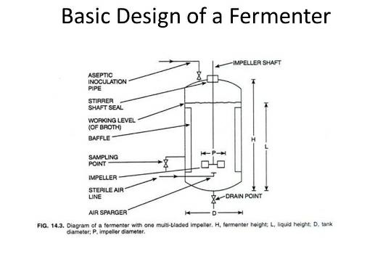

Slide 5
Aeration and Agitation.
• Aeartion provides oxygen to culture.
• Removes unwanted volatile products of metabolis.
• Agitation either by stirring or as a side effect of aeration

Slide 6
Importance of Agitation.
1. To increase the rate of oxygen transfer from the air bubble to the liquid medium.
2. To increase the rate of oxygen and nutrients transfer from the medium to cells.
3. To prevent formation of clumps of cells, aggregates of mycelium.
4. To increase the rate of transfer of product of metabolism from cell to medium.
5. To increase the rate or efficiency of heat transfer between the medium and the cooling surfaces of the fermenters.

Slide 7
Effect of agitation upon aeration.
1. by dispersing the air in smaller bubble.
2.by causing the bubbles to follow a more tortuous path and dalaying their escape from the culture.
3. by preventing the coalescence of bubbles.
4. by decreasing the rate-limiting thickness of the liquid film at the gas/liquid interface.

Slide 8
Oxygen supply affected by following:
1. Type of agitation: The shape, number and arrangement of impellers and baffles. Either 2 or 3 impellers for large fermenters at suitable level on the stirrer shaft or 3 or 4 baffles on the wall of the vessel.
2. Speed of agitation: 1000 or more for lab. Fermenters. But this is not possible for large vessels. For penicillin fermentation requires 50rpm needs high input of energy and uneconomical.
3. Depth of liquid in the fermenters: Bubble remain longer in the medium of a tall, deep fermenter. Greater hydrostatic pressure at the sparger improves solution of oxygen. Height : diameter ratio of 3:1 or 4:1 is common.

Slide 9
4. Type of sparger: One single opening preferred to produce large bubble.
5. Air flow: Aeration – increased by air flow rate, expressed in vvm (Vol. Of air/vol. Of medium/min.). Large fermenters cannot be supplied with air at greater rates than 0.5 to 1.0vvm.
6. Physical properties of the medium: Temp., viscosity, surface tension and nature of organism , all affects solubility of oxygen directly or by bubble size and turbulence.

Slide 10
THE AGITATOR
• Agitator is required to mix the following objectives:
• bulk fulid and gas-phase mixing, air dispersion, oxygen transfer, hear transfer, suspension of solid particles and maintaining uniform environment.
• Types: Disc turbines, vaned dics, open turbines of variable pitch and propellers , etc.
Disc turbine: It is with a series of rectangular vanes set in a vertical plane around the circumference .
• Vane disc: It is a series of rectangular vanes attached vertically to the underside. Air from the sparger hits the underside ot the disc and is displaced towards the vanes where the air bubbles are broken into smaller bubbles.

Slide 11
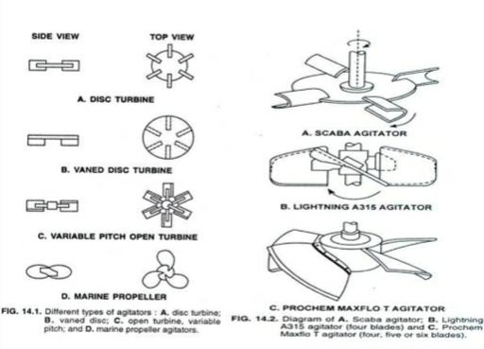

Slide 12
Stirrer glands and bearings
• Sealing of stirrer shaft – difficult problem in the construction of fermentation equip.
• Entry of stirrer shaft – top, side or bottom
• Basic type of seal assambly: • 1. the stuffing box (packed gland seal) • 2. the simple bush seal • 3. the mechanical seal • 4. the magnetic drive.
Baffles
• Four baffles to prevent vortex and to improve aeration efficiency. • Vessel with3dm3 – six to eight baffles.
• They are metal strips, one-tenth of vessel dia. And attached radially to the wall.
• Increased agitation with wider baffles; drop in agitation with narrower baffles.

Slide 13
The aeration system (Sparger).
• A sparger is a device for introducing air into the liquid in a fermenter. • Types: 1. Porous sparger 2. The orifice sparger (a perforated pipe) 3.The nozzle sparger ( an open or partially closed pipe
1.Porous sparger:• Made of Sintered glass, ceramics or metal.
• The bubble size produced from spargers is always 10 to 100 times larger than the pore size of the aerator block.
2. Orifice sparger: • In small stirred fermenters the perforated pipes were arranged below the impeller in the form of crosses or rings.
• Orifice spargers without agitation used in yeast manufacturing, effluent treatment and in SCP production

Slide 14
3.Nozzle sparger :• It’s a single open or partially closed pipe, provides stream of air bubbles.
• The single nozzle sparger causes a lower pressure loss than any other sparger and normally does not get blocked.

Slide 15
Thank you.

