Slide 1
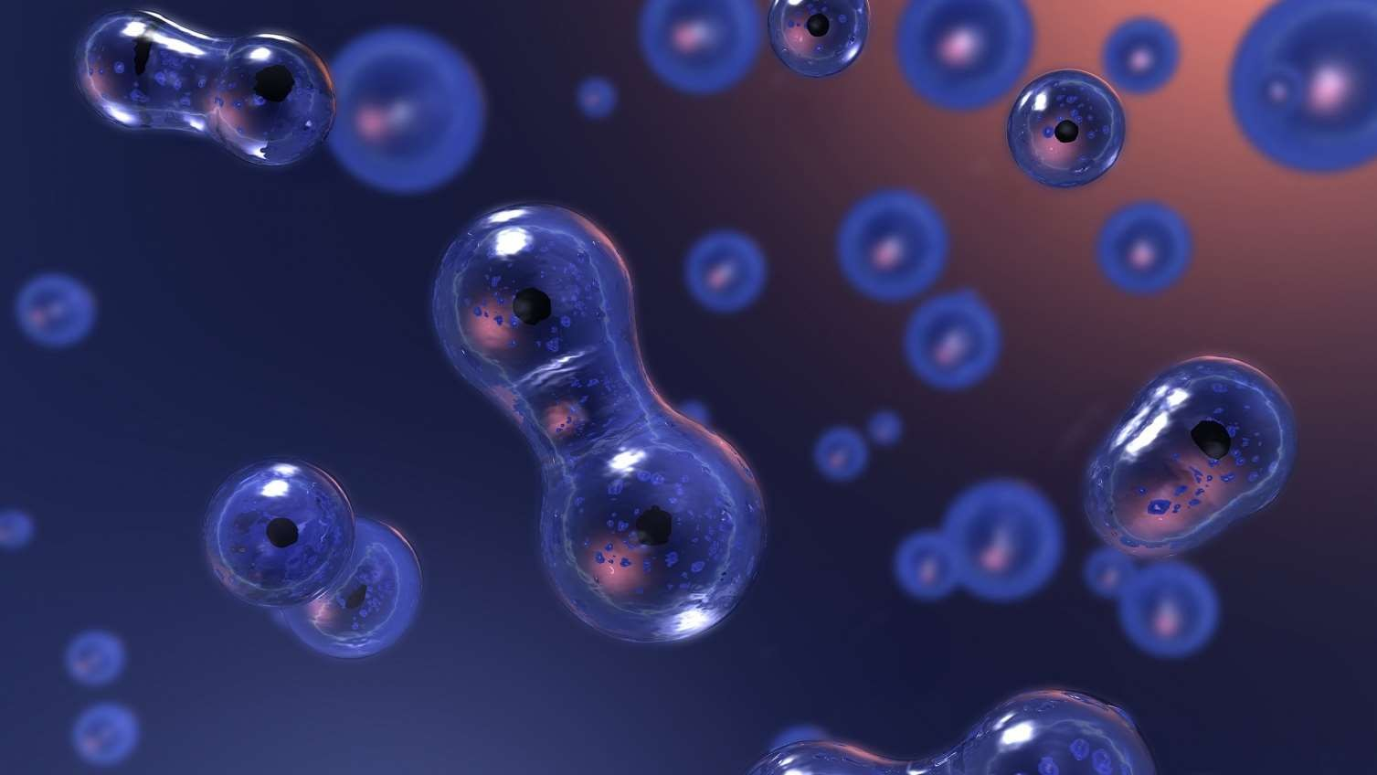
CELL
T h e F u n d a m e n t a l U n i t O f L i f e
Miss. Anjali Sarjerao Kale.
MS.c. Biochemistry
Assistant Professor,
Vivekananda College kolhapur

Slide 2
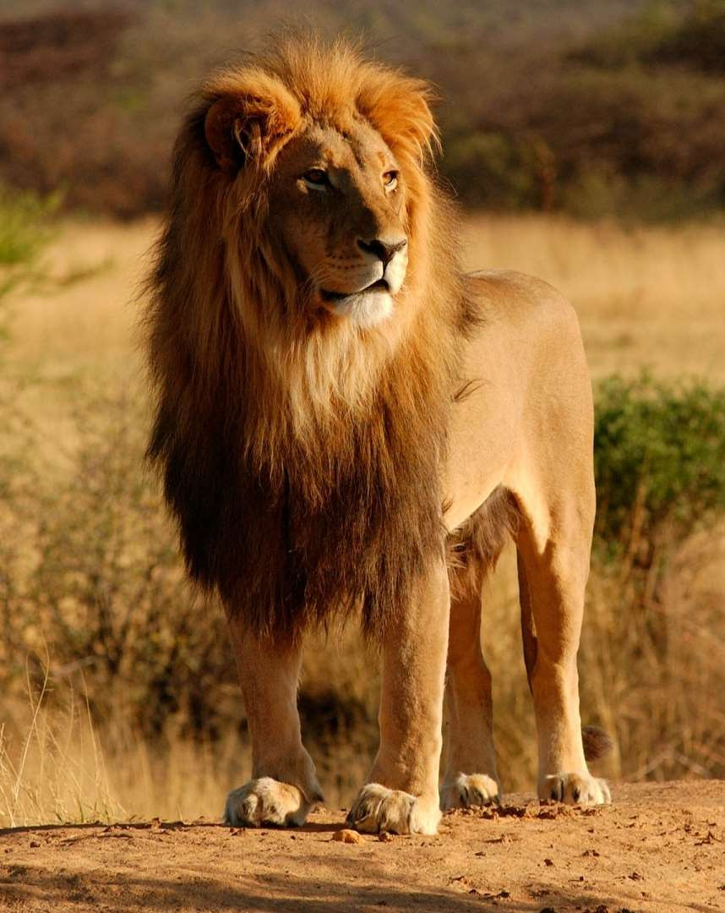
What is Cell?
Cell is the basic Structural and functional
unit of living organisms.
In other words, cells make up living things and carry out activities that keep a living thing alive.

Slide 3
Cell
Theory
1
All known l iving things are
made up of one or more cells.
2
All l iving cells arise from
pre- existing cells by division.
Cell theory is a collection of ideas and conclusions from many different scientists over time that describes cells and how cells operate.
3
The cell i s the basic unit of structure and function in all l iving organisms.

Slide 4
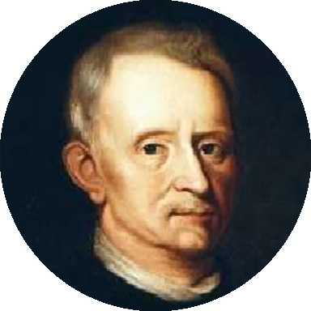
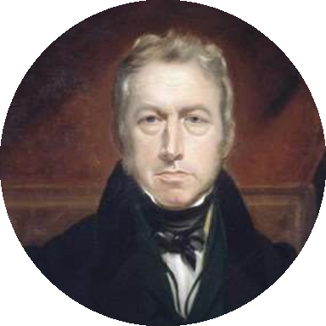
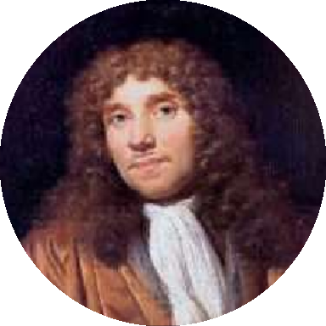
Cell Theory Timeline
1674
Anton Van Leeuwenhoek Observed living cell
1665
1883
Robert Brown Discovered nucleus
Robert Hooke Discovered cell

Slide 5
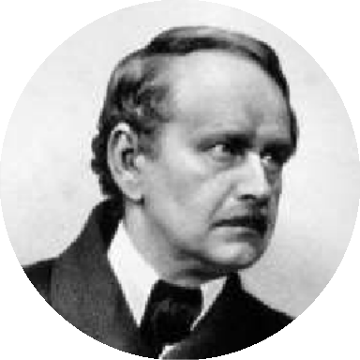
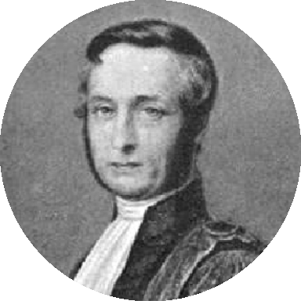
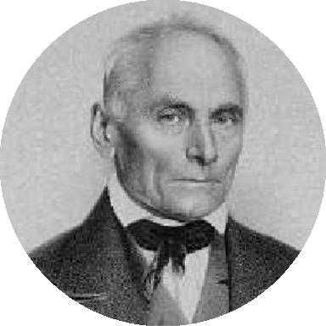
Cell Theory Timeline
1835
Felix Dujardin
Discovered fluid content of cell
1839
J. E. Purkinje Named fluid content of
cell as protoplasm
1838
Matthias Schleiden
Proposed all plants are made up of cells

Slide 6
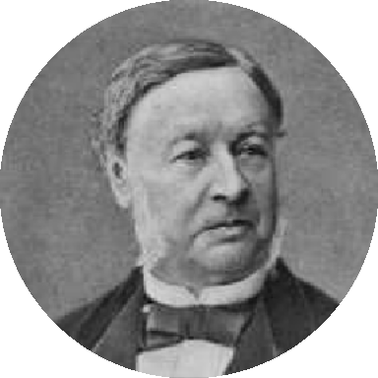
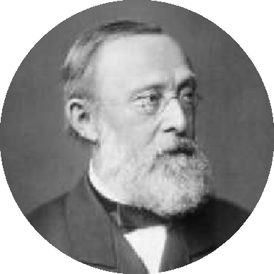
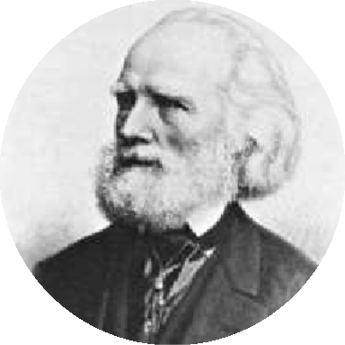
Cell Theory Timeline
1845
Carl Heinrich Braun
Proposed cell is the basic unit of life
1839
Theodor Schwann
Proposed all animals are made up of cells
1855
Rudolf Virchow
Proposed all cells arise from pre-existing cells

Slide 7

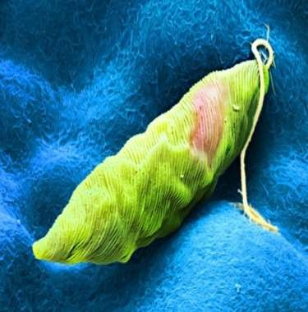
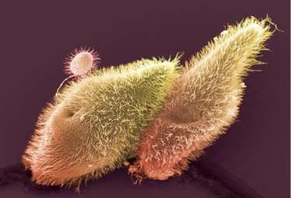
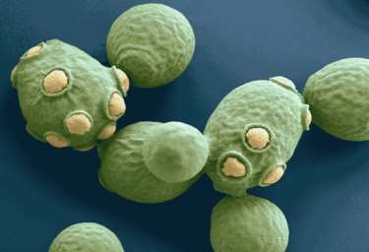
Unicellular Organisms
An organism that is made up of only one cell is called as unicellular organism.
Euglena
Paramecium
Yeast

Slide 8
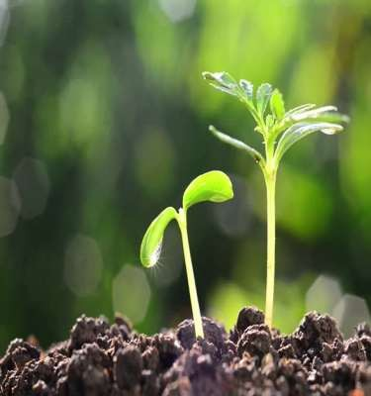
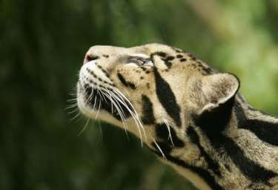
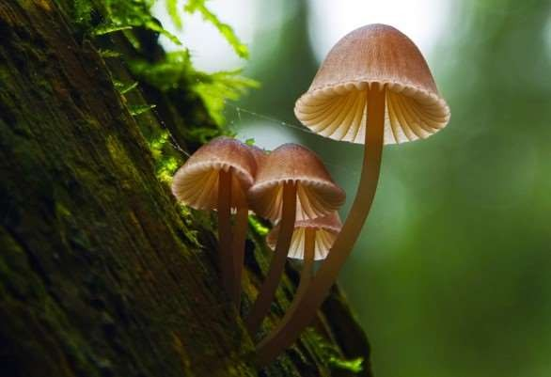
Multicellular Organisms
An organism that is made up of more than one cell is called as multicellular organism.
Plants
Animals
Fungus

Slide 9

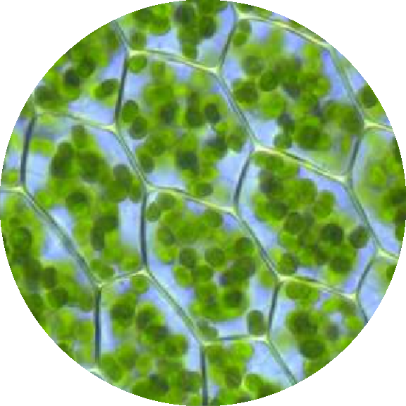
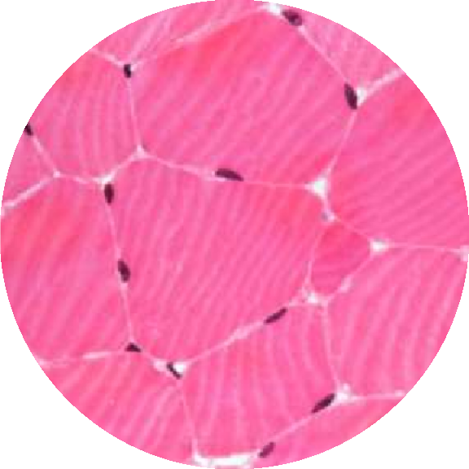
Multicellular Organisms Under Microscope
Leaf cells
Muscle cells

Slide 10
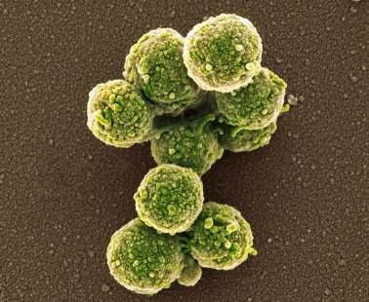
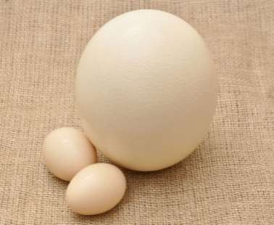
Size of Cells
Smallest cell
Mycoplasma
Size: 0.1 µm
Cells vary in size.
Most cells are very small (microscopic), some may be very large (macroscopic).
Largest cell
Ostrich egg
Size: 18 cm
The unit used to measure size
of a cell is micrometer.
1 µm = 1 / 1000 millimeter

Slide 11

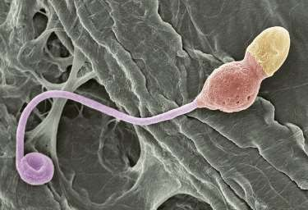
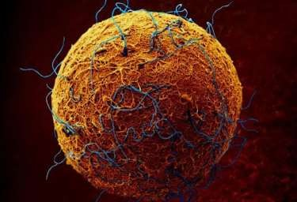
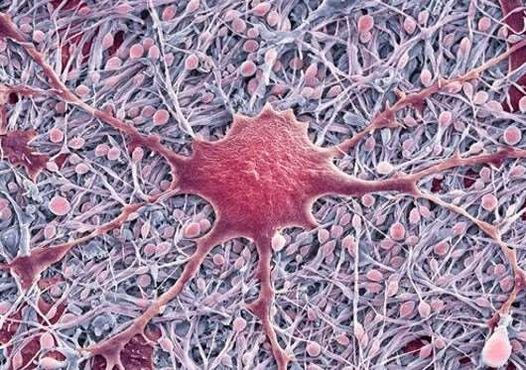
Size of Cells in Humans
Smallest cell Sperm cell Size: 5 µm
Largest cell Ovum cell Size: 120 µm
Longest cell Nerve cell Size: 1 m

Slide 12
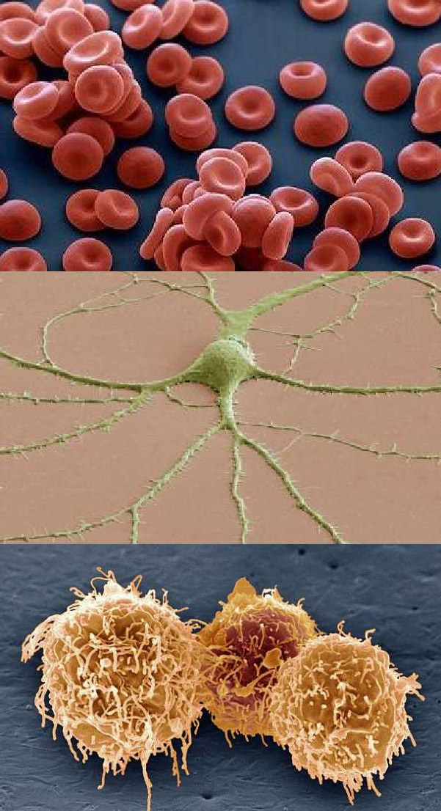
Shape of Cells
Human RBCs are circular biconcave for easy passage through human capillaries.
Cells vary in shape.
Variation depends mainly upon the function of cells.
Some cells like Euglena and Amoeba can change their shape, but most cells have a fixed shape.
Nerve cells are branched to conduct impulses from one point to another.
Human WBCs can change their shape to engulf the microorganisms that enter the body.

Slide 13
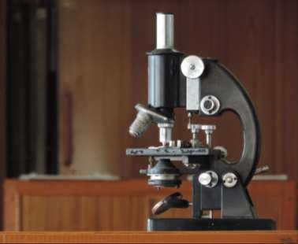
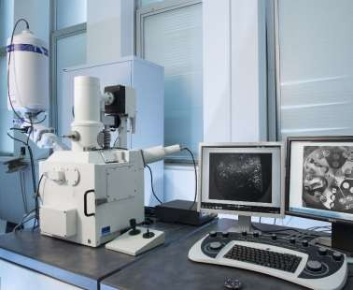
Structure Of Cell
Compound
microscope
Magnification 2000X
The detailed structure of a cell has been studied under compound microscope and electron microscope.
Certain structures can be seen only under an electron microscope.
Electron microscope
Magnification 500000X
The structure of a cell as seen under an electron microscope is called ultrastructure.

Slide 14
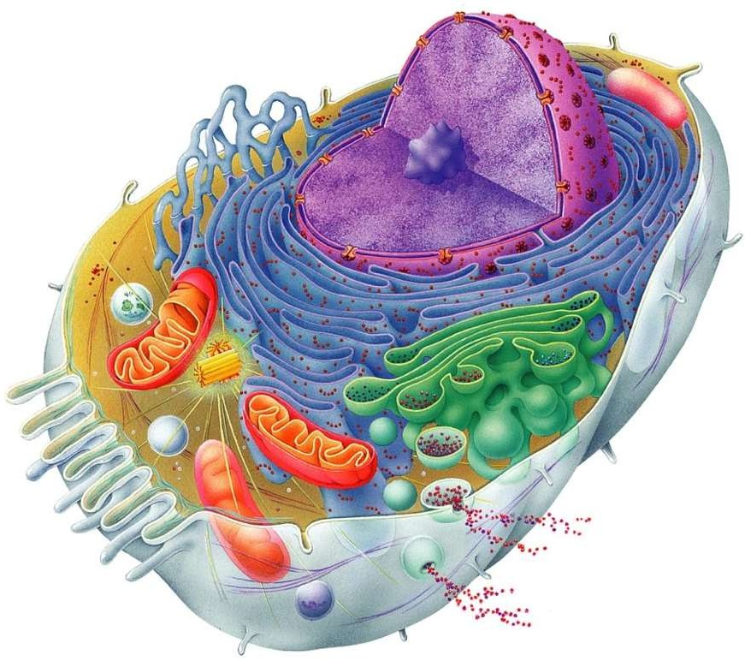
Animal Cell
11
12
1
10
Nucleus
Golgi body
Vesicle
Plasma membrane
Mitochondria
Cytoskeleton
Centriole
Lysosome
Cytoplasm
Rough endoplasmic reticulum
Smooth endoplasmic reticulum
Nucleolus
9
8
2
7
3
4
6
5

Slide 15
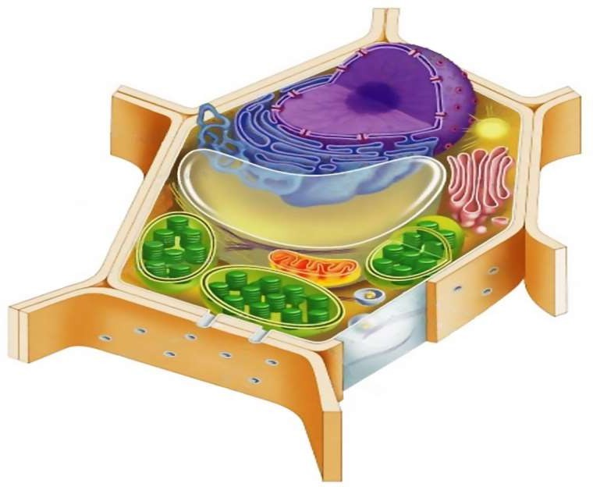
Plant Cell
11
12
1
10
Nucleus
Golgi body
Vesicle
Lysosome
Plasma membrane
Mitochondria
Chloroplast
Cell wall
Vacuole
Smooth endoplasmic reticulum
Rough endoplasmic reticulum
Nucleolus
9
2
8
3
4
5
7
6

Slide 16
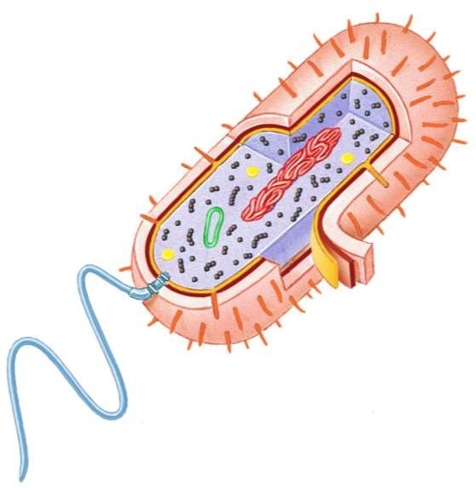
Bacterial Cell
10
9
8
Capsule
Cell wall
Plasma membrane
Cytoplasm
Flagellum
Food granule
Plasmid (DNA)
Ribosomes
Nucleoid
7
6
1
2
3
4
5
10. Pili

Slide 17
Structure Of Cell
Plasma Membrane
Nucleus
Cytoplasm
Cytosol
Cell Organelles
If we study a cell under a microscope,
we would come across three features
in almost every cell: plasma membrane, nucleus and cytoplasm.
All activities inside the cell and interactions of the cell with its environment are possible due to these features.
Endoplasmic reticulum
Golgi body
Lysosomes
Vacuoles
Mitochondria
Plastids
Centrosome
Cytoskeleton

Slide 18
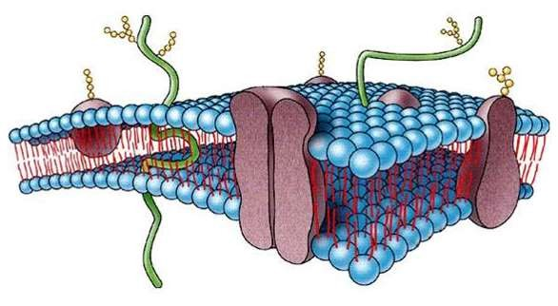
Plasma Membrane
Extremely delicate, thin , elastic, living and semi-permeable membrane
Made up of two layers of lipid molecules
in which protein molecules are floating
Thickness varies from 75-110 A˚
Can be observed under an electron microscope only
Carbohydrates
Functions:
Maintains shape & size of the cell
Protects internal contents of the cell
Regulates entry and exit of substances in and out of the cell
Maintains homeostasis
Proteins
Lipids

Slide 19
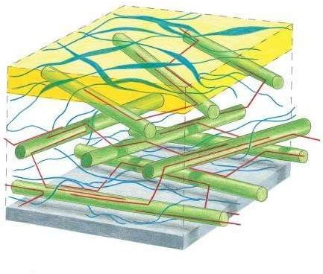
Cell wall
Non-living and outermost covering of a cell (plants & bacteria)
Can be tough, rigid and sometimes flexible
Made up of cellulose, hemicellulose and pectin
May be thin or thick, multilayered structure
Thickness varies from 50-1000 A˚
Pectin
Cellulose
Functions:
Provides definite shape, strength & rigidity
Prevents drying up(desiccation) of cells
Helps in controlling cell expansion
Protects cell from external pathogens
Plasma membrane
Hemicellulose

Slide 20
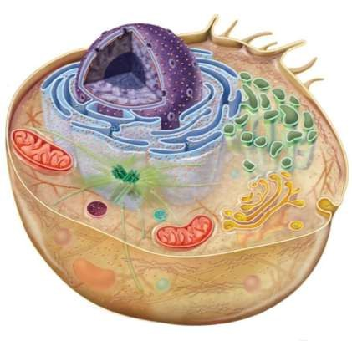
Nucleus
Dense spherical body located near the centre of the cell
Diameter varies from 10-25 µm
Present in all the cells except red blood cells and sieve tube cells
Well developed in plant and animal cells
Undeveloped in bacteria and blue-green algae (cyanobacteria)
Most of the cells are uninucleated (having only one nucleus)
Few types of cells have more than one nucleus (skeletal muscle cells)
Nucleus

Slide 21
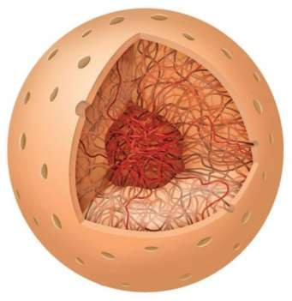
Nucleus
Nucleus has a double layered covering called nuclear membrane
Nuclear membrane has pores of diameter
about 80-100 nm
Colourless dense sap present inside the nucleus known as nucleoplasm
Nucleoplasm contains round shaped nucleolus and network of chromatin fibres
Fibres are composed of deoxyribonucleic acid (DNA) and protein histone
These fibres condense to form chromosomes
during cell division
Nuclear
pores
Nucleolus
Chromatin
Nuclear envelope
Nucleoplasm

Slide 22
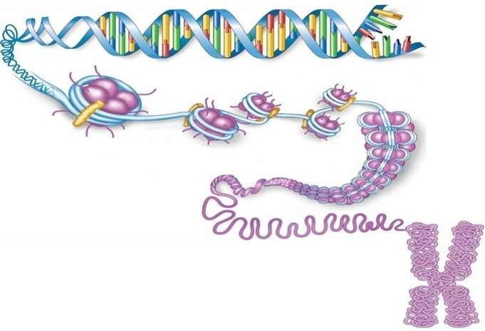
Nucleus
Gene
DNA
Chromosomes contain stretches of DNA called genes
Genes transfer the hereditary information
from one generation to the next
Chromatin
Functions:
Control all the cell activities like metabolism, protein synthesis, growth and cell division
Nucleolus synthesizes ribonucleic acid (RNA) to constitute ribosomes
Store hereditary information in genes
Histone
Chromatin fibre
Chromosome

Slide 23
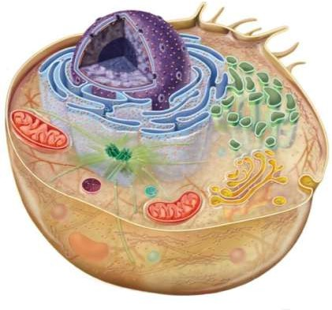
Cytoplasm
Jelly-like material formed by 80 % of water
Present between the plasma membrane and the nucleus
Contains a clear liquid portion called
cytosol and various particles
Particles are proteins, carbohydrates, nucleic acids, lipids and inorganic ions
Also contains many organelles with distinct structure and function
Some of these organelles are visible only under an electron microscope
Granular and dense in animal cells and thin in plant cells
Organelles
Cytoplasm

Slide 24
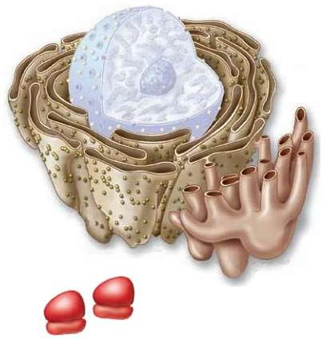
Endoplasmic Reticulum
Network of tubular and vesicular structures which are interconnected with one another
Some parts are connected to the nuclear membrane, while others are connected to the cell membrane
Two types: smooth(lacks ribosomes) and rough(studded with ribosomes)
Functions:
Gives internal support to the cytoplasm
RER synthesize secretory proteins and membrane proteins
SER synthesize lipids for cell membrane
In liver cells SER detoxify drugs & poisons
In muscle cells SER store calcium ions
Rough ER
Smooth ER
Ribosomes

Slide 25
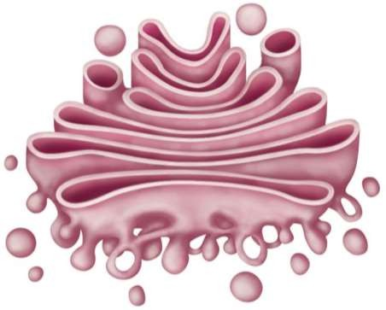
Golgi body
Discovered by Camillo Golgi
Formed by stacks of 5-8 membranous sacs
Sacs are usually flattened and are called
the cisternae
Has two ends: cis face situated near the endoplasmic reticulum and trans face situated near the cell membrane
Incoming
Cis face
transport vesicle
Cisternae
Lumen
Functions:
Modifies, sorts and packs materials synthesized in the cell
Delivers synthesized materials to various targets inside the cell and outside the cell
Produces vacuoles and secretory vesicles
Forms plasma membrane and lysosomes
Newly forming vesicle
Outgoing transport vesicle
Trans face

Slide 26

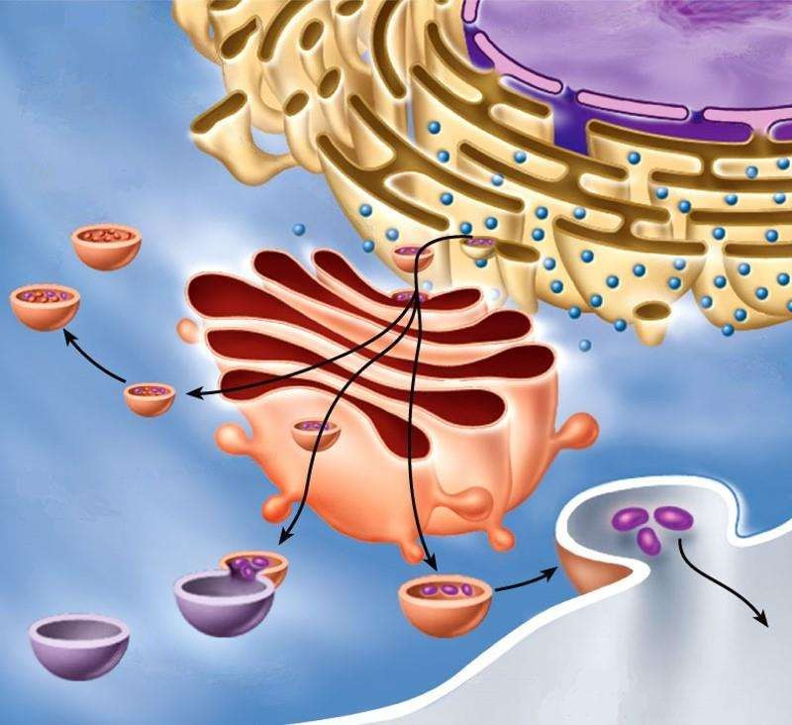
Nucleus
Smooth ER
Lysosomes
Golgi Body At Work
Rough ER
Golgi body
Plasma
membrane
Vesicles

Slide 27
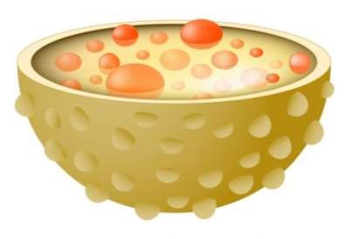
Lysosomes
Small, spherical, single membrane sac
Found throughout the cytoplasm
Filled with hydrolytic enzymes
Occur in most animal cells and in few type of plant cells
Hydrolytic enzymes
Membrane
Functions:
Help in digesting of large molecules
Protect cell by destroying foreign invaders like bacteria and viruses
Degradation of worn out organelles
In dead cells perform autolysis

Slide 28
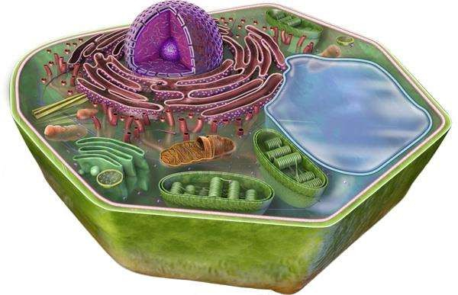
Vacuoles
Single membrane sac filled with liquid or sap (water, sugar and ions)
In animal cells, vacuoles are temporary, small in size and few in number
In plant cells, vacuoles are large and more
in number
May be contractile or non-contractile
Tonoplast
Functions:
Store various substances including waste products
Maintain osmotic pressure of the cell
Store food particles in amoeba cells
Provide turgidity and rigidity to plant cells
Vacuole

Slide 29
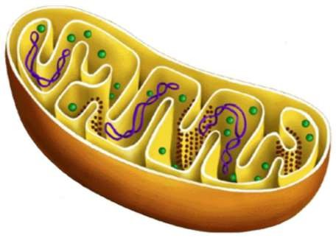
Mitochondria
Small, rod shaped organelles bounded by two membranes - inner and outer
Outer membrane is smooth and encloses the contents of mitochondria
Inner membrane is folded in the form of shelf like inward projections called cristae
Inner cavity is filled with matrix which contains many enzymes
Contain their own DNA which are responsible
for many enzymatic actions
Ribosomes
Matrix
Cristae
DNA
Functions:
Synthesize energy rich compound ATP
ATP molecules provide energy for the vital activities of living cells
Outer membrane
Inner membrane

Slide 30
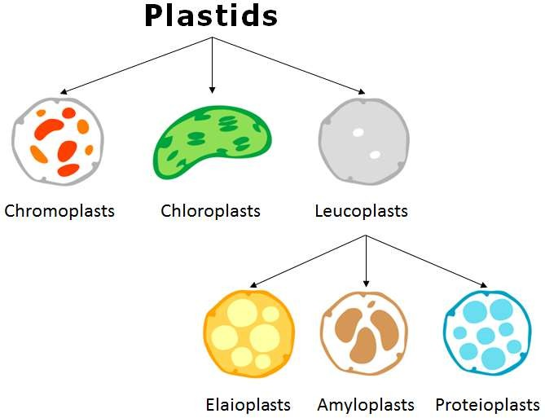
Plastids
Plastids are double membrane-bound organelles found inside plants and some algae.
They are responsible for activities related to making and storing food.
They often contain different types of pigments that can change the colour of the cell.

Slide 31
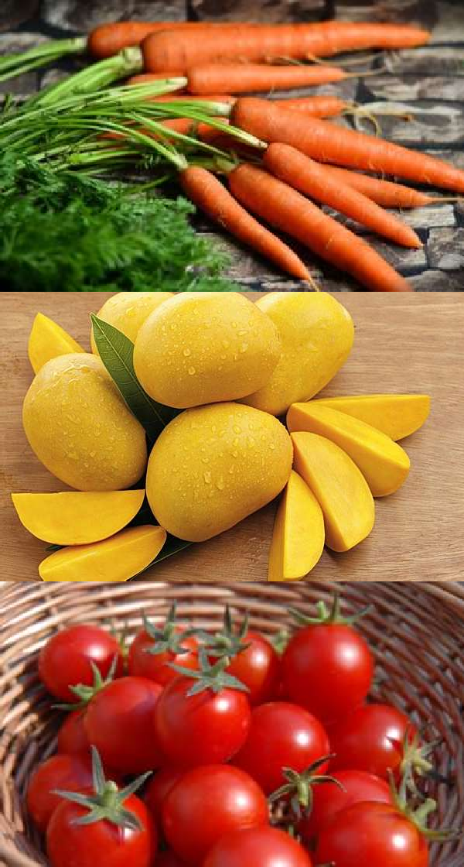
Carrot
Chromoplasts
Pigment: Carotene
Mango
Pigment: Xanthophyll
Chromoplasts are plastids that produce and store pigments
They are responsible for different colours found in leaves, fruits, flowers and vegetables.
Tomato
Pigment: Lycopene

Slide 32
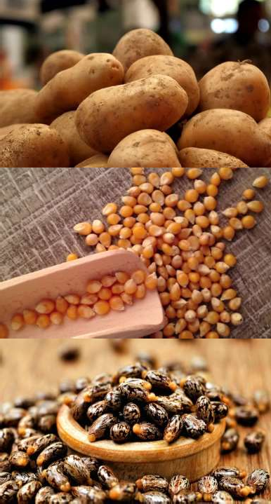
Potato tubers
Leucoplasts
Food: Starch
Maize grains
Food: Protein
Leucoplasts are colourless plastids that store foods.
They are found in storage organs
such as fruits, tubers and seeds.
Castor seeds
Food: Oil

Slide 33
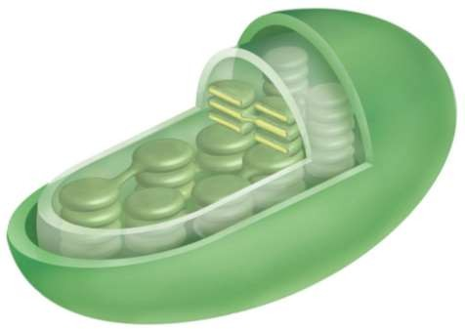
Chloroplasts
Double membrane-bound organelles found
mainly in plant cells
Usually spherical or discoidal in shape
Shows two distinct regions-grana and stroma
Grana are stacks of thylakoids (membrane-
bound, flattened discs)
Thylakoids contain chlorophyll molecules which are responsible for photosynthesis
Stroma is a colourless dense fluid
Inner membrane
Outer membrane
Thylakoid
Functions:
Convert light energy into chemical energy in the form of food
Provide green colour to leaves, stems and
vegetables
Stroma
Granum

Slide 34
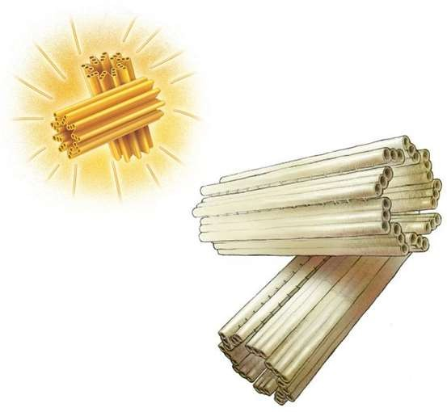

Centrosome
Centrosome is the membrane bound organelle present near the nucleus
Consists of two structures called centrioles
Centrioles are hollow, cylindrical structures
made of microtubules
Centrioles are arranged at right angles to each other
Centrosome
matrix
Microtubules
Functions:
Centrioles
Form spindle fibres which help in the movement
of chromosomes during cell division
Help in the formation of cilia and flagella

Slide 35
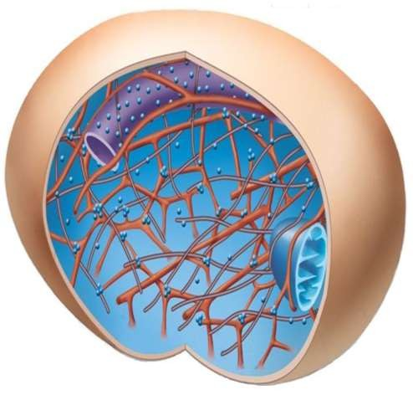
Cytoskeleton
Formed by microtubules and microfilaments
Microtubules are hollow tubules made up of protein called tubulin
Microfilaments are rod shaped thin filaments
made up of protein called actin
Cell membrane
Functions:
Determine the shape of the cell
Give structural strength to the cell
Responsible for cellular movements
Microtubules
Microfilaments

Slide 36
Prokaryotic cell
Eukaryotic cell
Nucleus is undeveloped
Only one chromosome is present
Membrane bound organelles are absent
Size ranges from 0.5-5 µm
Examples: Bacteria and blue green algae
Nucleus is well developed
More than one chromosomes are present
Membrane bound organelles are present
Size ranges from 5-100 µm
Examples: All other organisms

Slide 37
Animal cell
Plant cell
Generally small in s i ze
Cell wall i s absent
Plastids are absent
Vacuoles are smaller in s i ze and less in number
Centrioles are present
Generally large in s i ze
Cell wall i s present
Plastids are present
Vacuoles are larger in s i ze and more in number
Centrioles are absent

Slide 38

THANK YOU...

