Slide 1


“Education for Knowledge, Science and Culture”
- Shikshanmaharshi Dr. Bapuji Salunkhe
Shri Swami Vivekanand Shikshan Sanstha’s
VIVEKANAND COLLEGE , KOLHAPUR (EMPOWERED AUTONOMOUS)
DEPARTMENT OF BIOTECHNOLOGY (ENTIRE)
‘Laminar Air Flow’
Lecture conducted by :- Miss. V. N. Arekar

Slide 2
Content of the topic:
Definition
Principle
Parts
Working of LAF
Procedure of LAF
Types of LAF
Applications
Precautions

Slide 3
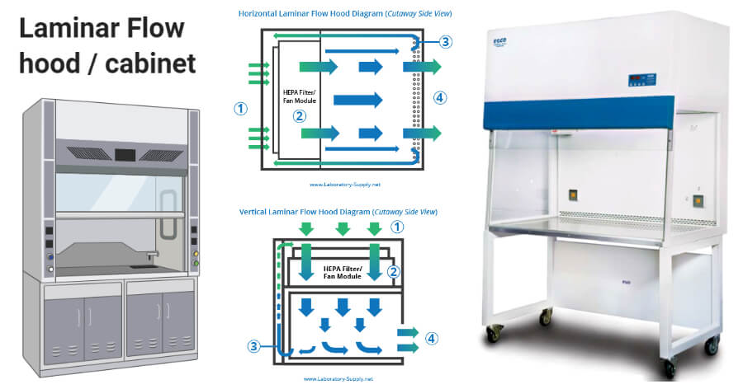
What is Laminar air flow?
A Laminar flow hood/ cabinet is an enclosed workstation that is used to create a contamination free work environment through filters to capture all the particles entering the cabinet.
Principle:
The laminar air flow cabinet works on the principle of laminar flow of air through the cabinet. The flow of air is laminar as the gas molecules travels parallelly in multiple straight lines without mixing with each other.

Slide 4











1. Cabinet
5. Fluorescent lamp
2. Working station
Parts of Laminar
Air Flow
3. Filtration system: Filter pad/ Pre-filter
Fan/Blower
HEPA filter
4.UV lamp

Slide 5
Parts of Laminar Air Flow:
Cabinet :
The cabinet of laminar flow chamber is typically made up of stainless steel with less/no gaps, joints preventing collection of spores. It protects sterile inner environment of laminar flow hood from outer environment. The front side of the cabinet is provided with glass shield where the work has been done by the user.
Working station:
Inside of the cabinet, a flat working station is present to carry out processes which we want to be done. Culture plates, glass beaker, petridishes, test tubes, burners etc are placed on the working station where the operation takes place. The working station is generally made up of stainless steel to avoid corrosion or rusting.

Slide 6
Continue…
Filter pad/ pre-filter :
The Filter pad is also known as pre-filter or primary filter as it capture the impure particles (e.g dust particles, microbes etc) of size 5 microns or higher than 5 microns. It initially sucks the air and done the filtration of air.
Fan/ Blower:
The fan or blower sucks the pre-filtered air through filter pad and allow the
air to move towards HEPA filter to trap remaining microbes.

Slide 7
Continue…
HEPA filter :
HEPA filter stands for high efficiency particulate air filter which is an air filter present inside the chamber that removes the particles including bacteria, fungi and dust particles to maintain a sterile and safe environment. This HEPA filter is a secondary or a final filter that traps particles about 0.3 microns in size, thus reduces the chances of airborne contamination.
The filter pads, fan/ blower and HEPA filters are collectively known as filtration system.

Slide 8
Continue…
UV light:
The laminar flow hoods are provided with a UV germicidal lamp that sterilizes the interior of the cabinet and contents before operation. UV lamp purifies the chamber as well as the other equipments present inside it. The UV lamp is turned on about 15-20 min before start any operation/ work to prevent the exposure of UV to the body surface of the user.
Fluorescent lamp:
Fluorescent lamp is also present inside the cabinet to provide proper light during the operation.

Slide 9
Working of a laminar flow cabinet:
The laminar air flow cabinet works on the principle of laminar flow of air through the cabinet.
When the device is turned on, the blower and the fluorescent light gets activated. The air is taken through filtration system as it first passes through the filter pad/ pre-filter where large impure particles get eliminated.
Next the blower or fan directs the air towards the HEPA filters. Then HEPA filters trap the micro level contaminants such as bacteria, fungi and other particulate material so that the air pass from it, is a particulate free air (Sterile air).
The sterile air passes over working bench while coming out of the cabinet towards the face of the user/ operator.
The laminar flow hood is enclosed on the sides and constant positive air pressure is maintained to prevent invasion of contaminated external air into the cabinet.

Slide 10
Procedure for operating a laminar flow cabinet: Before doing any operation/ process, the cabinet should be analysed to
ensure that nothing susceptible to UV rays is present inside the cabinet
Before doing any operation/ process, the cabinet should be analyzed to ensure that nothing susceptible to UV rays is present inside the cabinet
The glass shield of the cabinet is closed and then the UV light is switched on, at about 15-20 min for sterilization of the working bench and then UV light is switched off
The airflow is switched on about 5 min before the operation begins
When the work is completed, the air flow and fluorescent lamp both are closed and the glass shield is also closed
The fluorescent light is turned on during the operation. For more protection, the working bench of the cabinet can be sterilized with disinfectants like 70% alcohol

Slide 11





Horizontal Laminar Flow Cabinet
Types of Laminar Air
Flow Cabinet
Vertical Laminar
Flow Cabinet

Slide 12
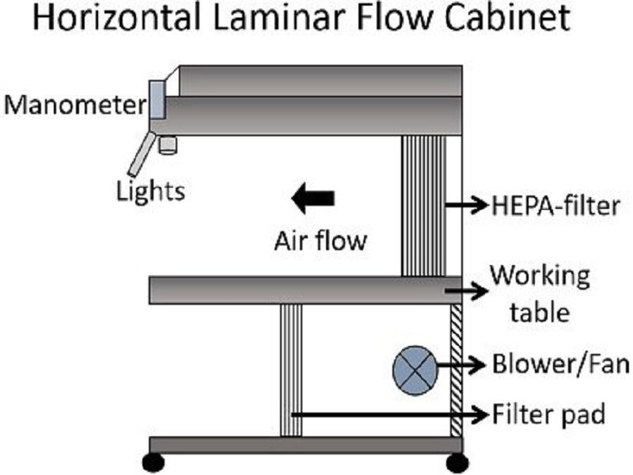
Types of laminar air flow cabinet:
Horizontal Laminar Air Flow Hood/Cabinet
In case of horizontal laminar air flow cabinet, filter pad is fixed at the bottom of the chamber and blower is located right next to the filter pad.
The input air entering from behind the laminar flow bench, gets sucked in with the help of the blower and is passed through the HEPA filter.
The filtered air passed in a horizontal direction to work bench.
Advantage of this cabinet is that airflow is parallel to the workplace that clean the environment with a constant velocity.
Disadvantage of this cabinet is, this system fails to provide security to the user while dealing with drugs like anti- neoplastic drugs as the waste air directly blows towards the user.

Slide 13
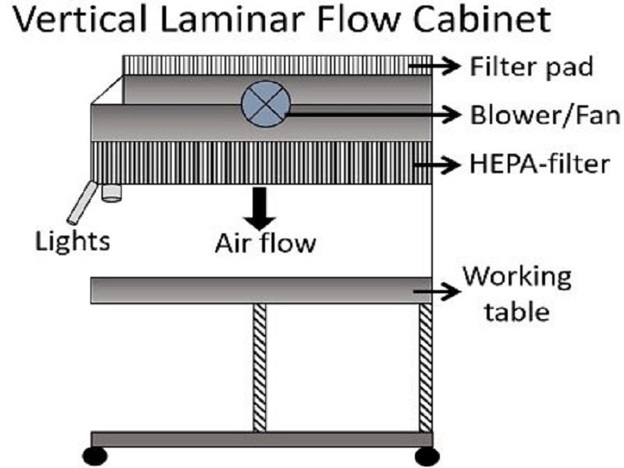
Continue…
In case of vertical laminar air flow cabinet, the air moves from the top of the cabinet directly towards bottom of the cabinet undergoing a positive pressure.
The filter pad is fixed at the top/ roof of the cabinet and blower is usually present right below the filter pad.
Hence the pre-filtered air is directed by blower towards HEPA filter and this sterile air move downwards in a vertical direction to the workplace.
Advantage - The air does not blow directly towards the user, it is considered to be safe.

Slide 14
Applications of laminar air flow cabinet:
Laminar flow cabinets are used in laboratories for contamination sensitive processes like plant tissue culture, animal tissue culture as well as IVF, pathology labs
Other laboratory processes like culturing of organisms, media plate preparation
In pharmaceutical industries, e.g. drug preparation techniques are also performed using this device

Slide 15
Precautions:
Before and after the work, the laminar flow cabinet should be sterilized with UV light.
The lab coat, long gloves and head cap is compulsory to the user/operator.
No operations should be carried out when UV light is switched on.
The working bench, glass shield, other components should be well sterilized before and after the completion of work.

Slide 16

Thank You

