Slide 1
LMS : Learning Management System
- Ms. P. C. Wakarekar.
Assistant Professor,
Vivekanand College, Kolhapur.

Slide 2
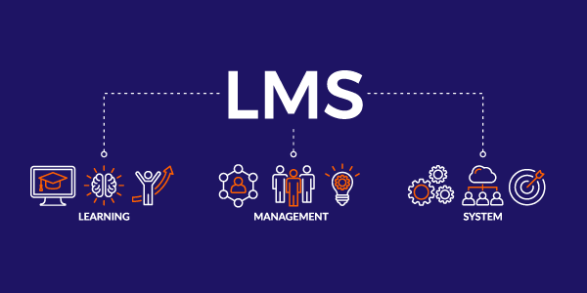

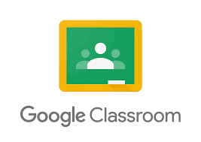
It is a software based educational framework which support entire process of learning and teaching in a digital environment.
Basically, it manages, analyzes and runs educational courses and training programs.
e.g. SWAYAM, Google Classroom etc.

Slide 3
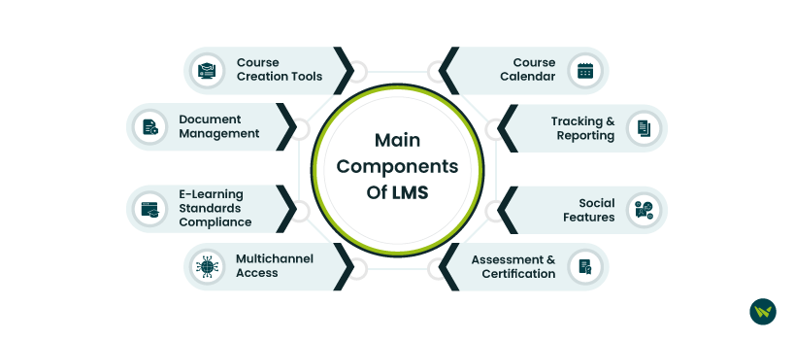

Slide 4
Features of LMS
Course Management: Add, edit, and organize lessons.
Customization: Change the look and settings as you like.
Blended Learning: Use both online and classroom teaching.
Social Learning: Students can chat, share, and learn together.
Gamification: Points, badges, and rewards to make learning fun.
Learning Paths: Arrange lessons in a step-by-step order.
Certification: Give certificates after completing courses.
Mobile Access: Learn using phone, tablet, or any device.

Slide 5
9. Reports: See student progress and performance easily.
10. E-commerce: Sell courses online.
11. Notifications: Send alerts and reminders to students.
12. Central Storage: Keep all learning files in one place.
13. Offline Tracking: Track learning even without internet.
14. Security: Keep user data safe and protected.
15. Assessments: Create quizzes and tests.

Slide 6


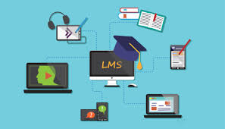
Steps in creating a LMS System
1.Plan
2.Choose Features
3.Decide How to Build
4.Design
5.Develop Panels
6.Upload Content
7.Test
8.Launch
9.Maintain & Improve

Slide 7



Step 1 – Plan
Decide purpose: What will students learn?
List features: quizzes, certificates, notifications
Step 2 – Choose Features
Courses, videos, PDFs
Quizzes and assignments
Certificates and rewards
Progress tracking and reports
Step 3 – Choose How to Build
Option 1: Ready-made LMS tools (Moodle, Google Classroom) → Quick & easy Option 2: Build your own → Developers use coding & database → Fully customizable

Slide 8
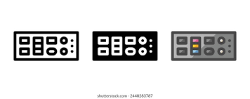
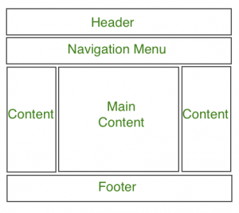


Step 4 – Design LMS
Create simple pages: Login, Courses, Dashboard
Make it easy to use and navigate
Step 5 – Develop Panels
Teacher panel: upload lessons, create quizzes
Student panel: view lessons, take tests
Admin panel: manage users, check reports
Step 6 – Upload Content
Add videos, PDFs, presentations, quizzes
Organize lessons step by step
Keep content clear and simple
Step 7 – Test the LMS
Check login for students & teachers
Test lessons, quizzes, and certificates
Fix errors before launch

Slide 9


Step 9 - Maintain & Improve
Update lessons & quizzes regularly
Add new features
Fix bugs & ensure smooth operation
Step 8 – Launch Online
Make LMS accessible online
Provide login details to students & teachers

Slide 10
How the LMS Systems works?
Upload content
Add users
Enroll learners
Start learning
Take tests
Track progress
Give feedback
Get certificates
Reports

Slide 11
Uses of LMS :
Central Hub for Course Content: Hosting all syllabi, readings, video lectures, and assignments in one place for students.
Facilitating Online and Hybrid Classes: Managing enrollment, content delivery, discussions, and grading for students who cannot physically attend a campus.
Tracking Student Progress: Monitoring which students have completed required modules or achieved specific learning milestones.
Administering Exams and Quizzes: Delivering secure online assessments and automatically grading multiple-choice exams for instant results.
Communication Forums: Providing a structured place for students to ask questions, collaborate on group projects, and engage in class discussions.
Resource Sharing (Libraries/IT): Integrating external resources, such as library databases or IT support documents, directly into the learning platform.
Global Training Consistency: Delivering the exact same quality and version of training content to employees in different offices or countries simultaneously.

