Slide 1
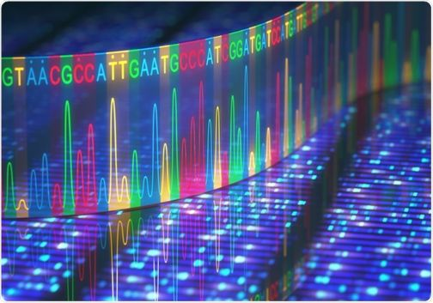
DNA Sequencing Methods
MS. P. C. Wakarekar.
Asst. Professor, Vivekanand College, Kolhapur.

Slide 2
DNA Sequencing Methods
DNA sequencing means determining the exact order of nucleotides (A, T, G, C) in a DNA molecule.
In simple terms, it helps us “read” the genetic code written in DNA.
Each gene or organism has its own unique DNA sequence, and knowing this sequences helps scientists to understand:
What genes are present,
What proteins they make,
And how mutations cause diseases.

Slide 3
Methods/Types of DNA Sequencing
There are mainly three classical types:
Sanger sequencing (Chain termination method)
Maxam–Gilbert sequencing (Chemical degradation method)
Automated DNA sequencing (Modern, machine-based version of Sanger method)

Slide 4
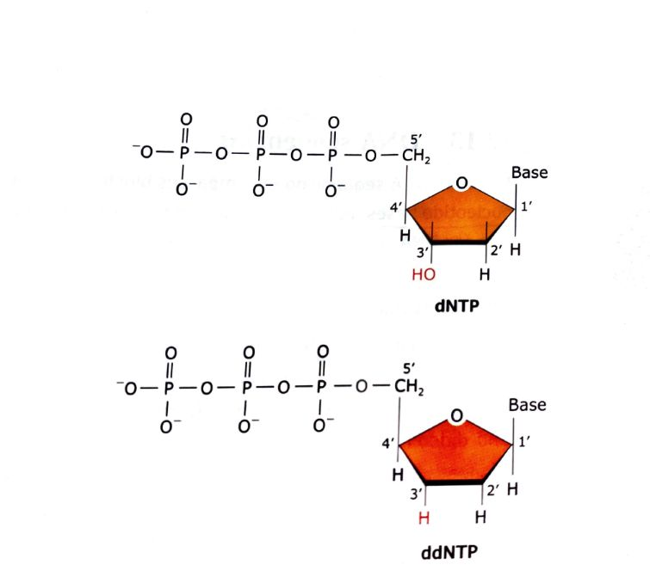
A. Sanger Sequencing (Chain Termination Method)
This method is developed by Frederick Sanger and colleagues at
Cambridge university in 1977.
Principle:
This method is based on selective incorporation of chain-terminating
nucleotides called dideoxynucleotides (ddNTPs) during DNA synthesis.
Normal DNA synthesis uses deoxynucleotides (dNTPs): A, T, G, C.
Dideoxynucleotides (ddNTPs) lack a –OH group at 3′ carbon,
so when they are added to a growing DNA chain,
no further nucleotides can be added → chain terminates.
Thus, each DNA fragment ends at a specific base depending on where the ddNTP got inserted.

Slide 5
Main Components of reaction:
Component | Function
Template DNA | DNA whose sequence is to be determined
Primer | Short DNA piece that starts the new strand
DNA Polymerase | Enzyme that adds nucleotides
dNTPs | Normal nucleotides (A, T, G, C) for chain elongation
ddNTPs | Chain-terminating nucleotides (ddATP, ddTTP, ddGTP, ddCTP)
Buffer, Mg²⁺ ions | Maintain proper reaction conditions

Slide 6
Procedure :
Denaturation – The double-stranded DNA is heated to separate into single strands.
Primer Annealing – A primer binds (anneals) to the single-stranded template.
Extension/Chain synthesis – DNA polymerase starts adding complementary bases.
Chain termination – When a ddNTP is randomly inserted, the chain stops growing.
Four separate reactions are done — each containing one type of ddNTP (e.g., one with ddATP, one with ddTTP, etc.).
Fragments of different lengths are produced, each ending with a known base.
The fragments are then separated on a polyacrylamide gel using gel electrophoresis.
By reading the order of bands (from bottom to top), we can determine the DNA sequence.

Slide 7
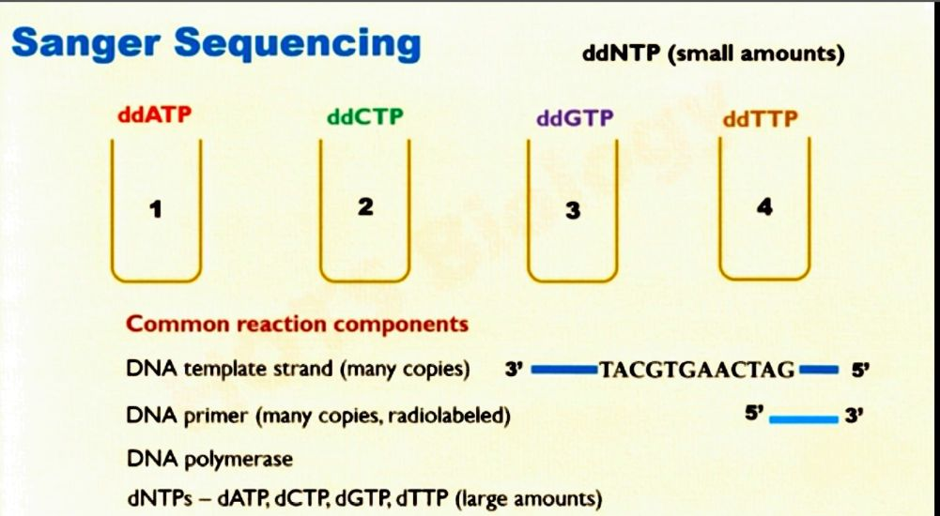
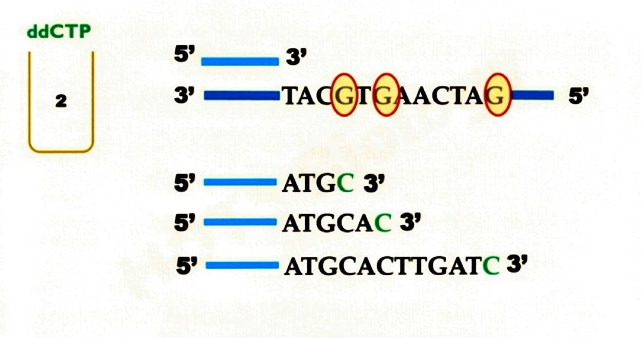

Slide 8
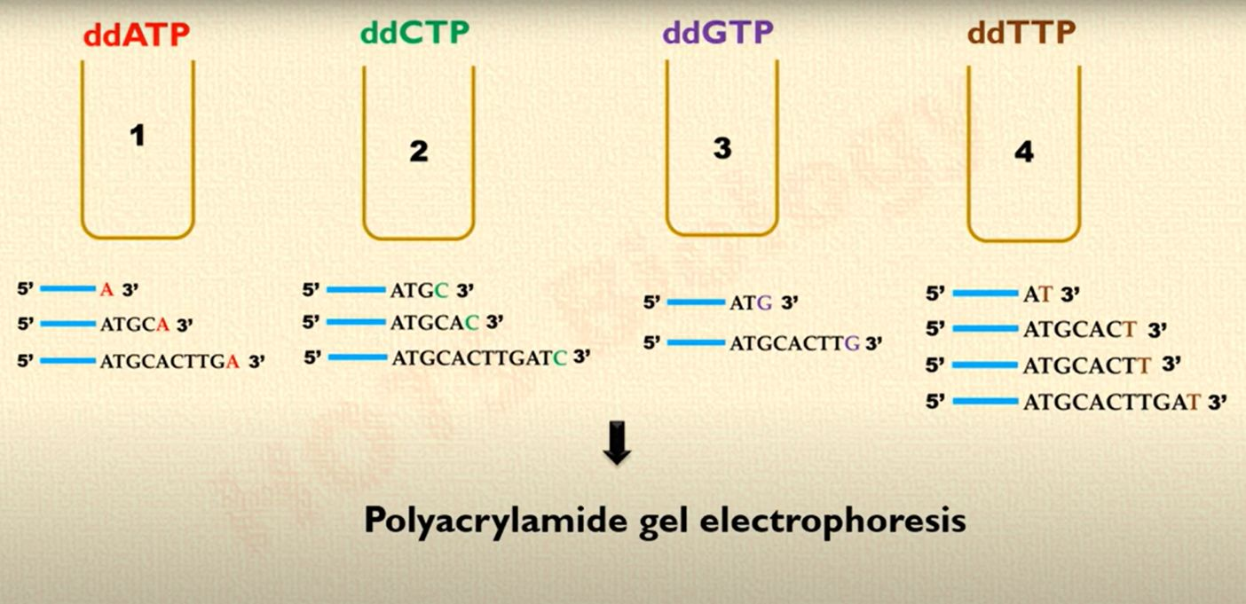

Slide 9
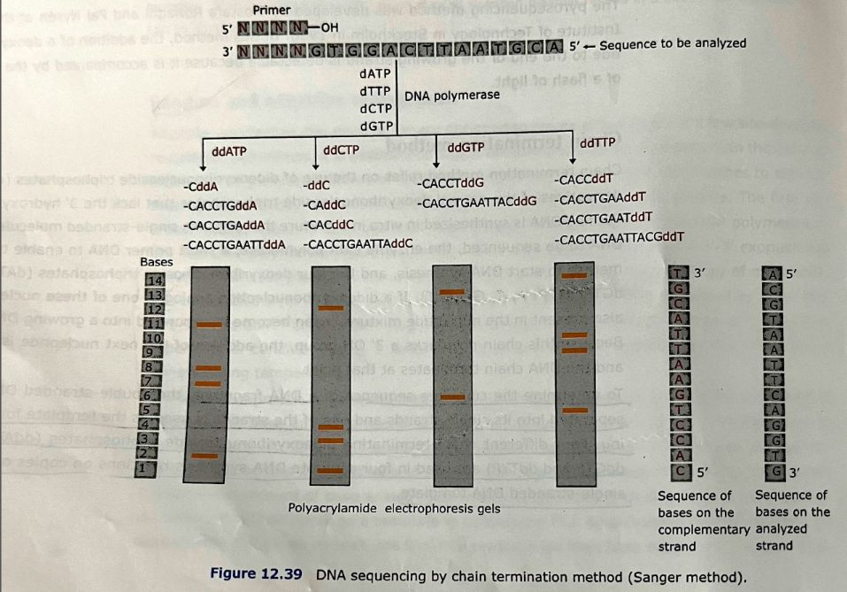

Slide 10
Advantages and disadvantages of Sanger Sequencing method
Advantages:
High accuracy (about 99.9%)
Simple and reliable for small DNA fragments (up to ~1000 bp)
Disadvantages:
Time-consuming
Requires radioactive or fluorescent labeling
Not suitable for sequencing large genomes directly

Slide 11
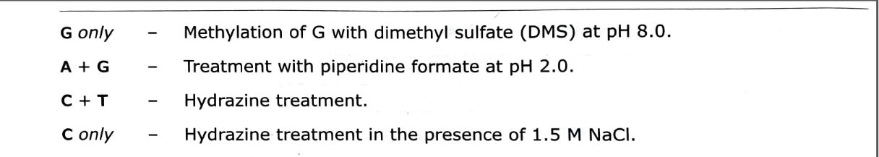
2. Maxam–Gilbert sequencing (Chemical degradation method)
This method is developed by: Allan Maxam and Walter Gilbert in 1977.
Principle:
This method is based on chemical modification and cleavage of DNA at specific bases (A, G, C, T).
Different chemicals are used to modify and break DNA at positions of specific nucleotides, and by comparing fragment lengths, the sequence is determined.
The cleavage reaction in this method have not changed significantly since it’s initial development. The chemical treatment used for base modification are:

Slide 12
Procedure :
Labeling – One end of the DNA strand is labeled (usually with radioactive phosphate).
Chemical treatment – DNA is divided into four tubes, and each is treated with a different chemical reagent that cuts at:
G only
A + G
C + T
C only
Cleavage – Chemicals modify specific bases and Piperidine treatment break the DNA backbone at those points.
Electrophoresis – Fragments of different lengths are separated by gel electrophoresis.
Autoradiography – The pattern of bands on X-ray film reveals the positions of each base.
By comparing bands from all four reactions, the DNA sequence can be deduced.

Slide 14
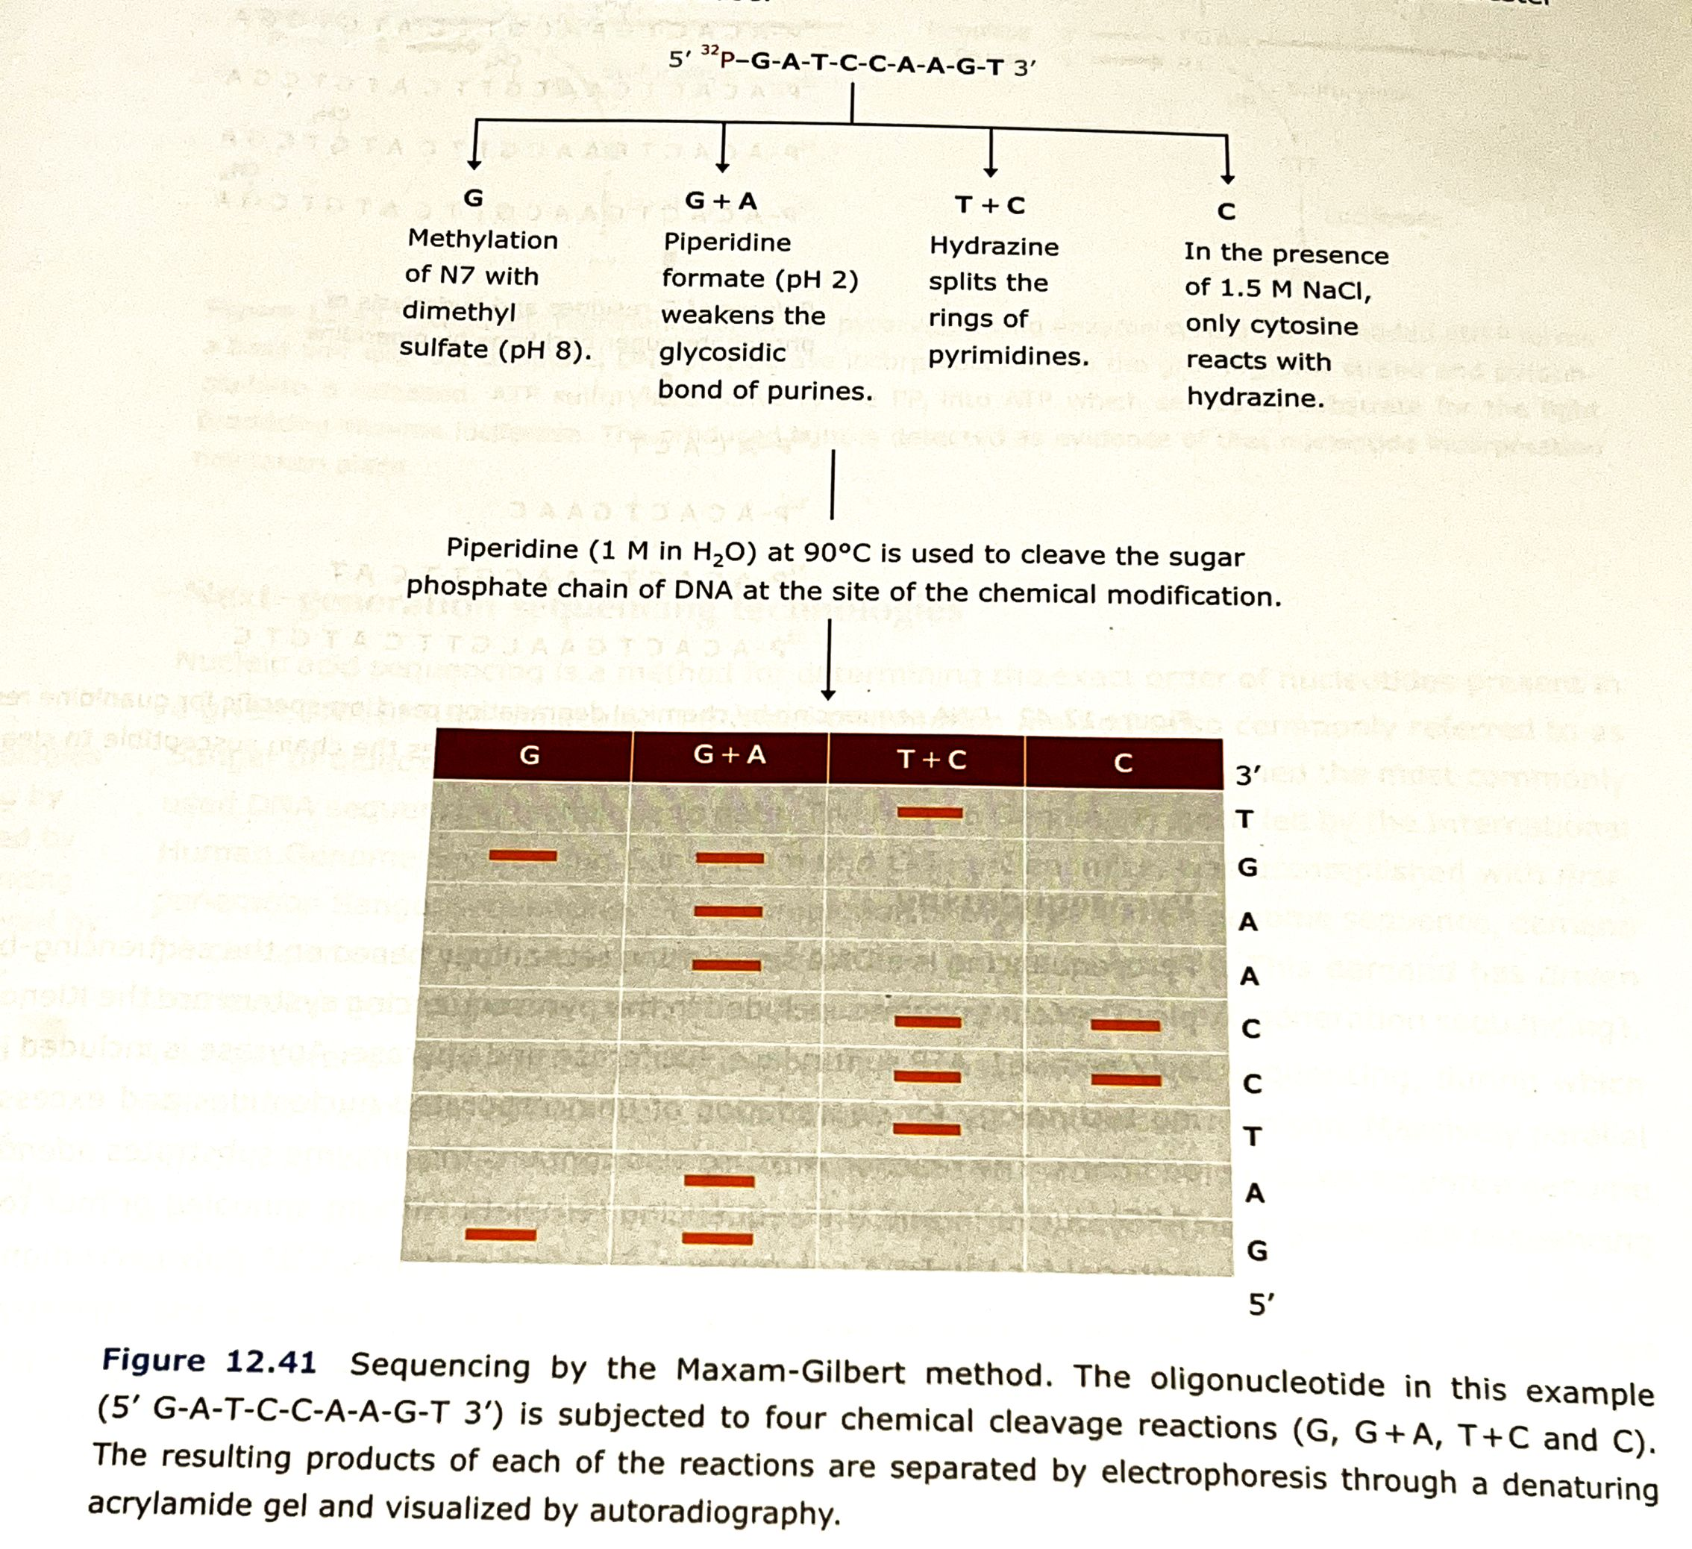

Slide 15
Advantages and Disadvantages of Maxam Gilbert sequencing:
Advantages:
No need for DNA polymerase or primers.
Can directly sequence purified DNA fragments.
Disadvantages:
Uses toxic chemicals (e.g., hydrazine, piperidine).
Complex and time-consuming.
Difficult to automate.
Rarely used today.

Slide 16
3.Automated DNA sequencing (Modern, machine-based version of Sanger method)
Automated sequencing is a modern version of the Sanger method, performed by machines (DNA sequencers).
It uses fluorescently labeled ddNTPs and capillary electrophoresis for fast, computer-based reading.
Principle:
Same as Sanger sequencing — chain termination by ddNTPs —
but each of the four ddNTPs is tagged with a different fluorescent dye, allowing all reactions to occur in a single tube.

Slide 17
Procedure:
DNA synthesis occurs using a mixture of normal dNTPs and fluorescent ddNTPs.
When a ddNTP is incorporated, the chain stops.
All terminated fragments of various lengths are generated in one reaction.
The fragments are separated by capillary electrophoresis (in thin tubes filled with gel).
As each fragment passes a laser detector, it emits fluorescence of a specific color (A = green, T = red, G = yellow, C = blue).
The computer records these colors and converts them into a chromatogram (graphical DNA sequence).

Slide 18
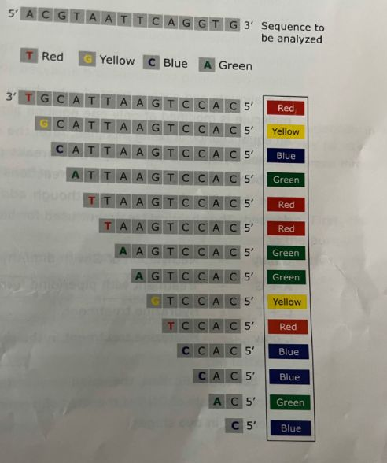

Slide 19
Advantages:
Fully automated and fast.
No radioactive materials used.
Computerized data storage and analysis.
Suitable for sequencing large genomes (e.g., Human Genome Project)
Disadvantages:
Expensive instrumentation.
Requires skilled operation.
Limited to relatively short read lengths (~800–1000 bases per run).

Slide 20
Feature | Sanger Method | Maxam–Gilbert Method | Automated Sequencing
Year | 1977 | 1977 | 1986 onwards
Developer | Frederick Sanger | Allan Maxam & Walter Gilbert | Modified Sanger (Applied Biosystems)
Principle | Chain termination using ddNTPs | Chemical cleavage at specific bases | Fluorescent ddNTP chain termination
Key Enzyme | DNA polymerase | None | DNA polymerase
Label Used | Radioactive or fluorescent | Radioactive | Fluorescent dyes
Chemicals Used | No harsh chemicals | Hazardous chemicals | None
Reading | Manual (gel) | Manual (autoradiogram) | Automated (laser detection)
Safety | Safe | Toxic | Very safe
Use Today | Moderate | Obsolete | Highly used

Slide 21
Applications of DNA Sequencing
Gene identification and mutation analysis
Forensic DNA fingerprinting
Evolutionary and phylogenetic studies
Personalized medicine
Biotechnology and genetic engineering
Human Genome Project (used automated Sanger sequencing)

