Slide 1
VIVEKANAND COLLEGE,KOLHAPUR (AUTONOMOUS)
Department of Commerce
Dr. Revati Patil
INDUSTRIAL RELATION

Slide 2
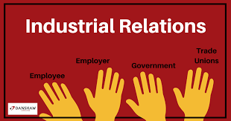

Slide 3
CONTENTS
Industrial relation meaning
Definition
Objectives of industrial relation
Scope of industrial relation
Measures to industrial relation

Slide 4
MEANING
it covers the relation between employer vs. employer and employees vs. employees.
In order to maintain good relationship & to ensure industrial peace and harmony with higher productivity.
IR is the process by which people and their organizations interact at the place of work to establish the terms and conditions of employment. –INDUSTRIAL DISPUTE ACT 1947.

Slide 5
DEFINITION
Industrial relations are relationship between management and employees or among employees and their organisations that characterise or grow out of employment.

Slide 6
OBJECTIVES OF IR
To enhance economic status of worker
To avoid industrial conflicts and their consequences
To extend and maintain industrial democracy
To provide an opportunity to the worker to have a say in the management decision making
To regulate production by minimizing conflicts
To encourage and develop trade union in order to develop woekers collective strength

Slide 7
SCOPE OF IR
The cordial and healthy labour management relations could be brought in-
By safeguarding the interest of the workers;
By fixing reasonable wages;
By providing good working conditions;
By providing other social security measures;
By maintaining healthy trade unions;

Slide 8
MEASURES TO IMPROVE IR
PROGRESSIVE MANAGEMENT OUT LOOK
STRONG AND SUITABLE UNIONS
MUTUAL TRUST
WORKERS PARTICIPATION IN MANAGEMENT
GOVERNMENT’S ROLE

Slide 9
REFERENCES:
Reviewed Work: The Elements of Industrial Relations Jack Barbash
Review by: Robert C. MiljusThe Academy of Management Review
Vol. 10, No. 2 (Apr., 1985), pp. 373-375 (3 pages)Published By: Academy of Management
The Industrial Disputes Act, 1947
The Trade Unions Act,1926 (25-03-1926)
The Industrial Disputes (Central) Rules,1957

Slide 10
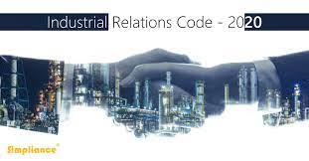

Slide 11
THANK YOU!

