Slide 1
Principles of Business Management Dr. Revati Patil Assistant Prof. Department of Commerce Vivekanand College Kolhapur.(Autonomous)

Slide 2
Introduction to Management
Meaning of Management
Definitions of Management
Characteristic of Management
Significance of Management
Functions of Management
Administration and Management
Management as A Science or an Art
Professional Management: The Concept, Characteristics and Need.
Summary
Exercise and Questions
References/ Further Reading
OUTLINE

Slide 3
Introduction to Management
Covid -19 era and effects of the world pandemic on personal & organizational life.
Management before and after Covid -19 .
Need to be more organized (Life / Organizations)
Good management is backbone
“GETTING THINGS DONE THROUGH OTHERS”
But……………. it is not simple as it seems.
DEBATE on what management is ?
some says…….formal management education is needed.
Hence included in degree programs.
Management is a set of principles related to the functions of P O D & C harnessing physical, financial, human & informational resources efficiently & effectively to achieve organizational goals.

Slide 4
Introduction:
In the primary stage of development human being where self sufficient after that their needs are increased and they became dependent on others they were aware of physical mental and environmental limitations to fulfill various needs of human being joint efforts and cooperation is essential which is the base of management people live in groups to direct group efforts to achieve group objectives management helps them management is the base of human development. basically management is not a new concept but there is a huge difference between different traditional management and modern management nature of management has changed due to change in situation

Slide 5
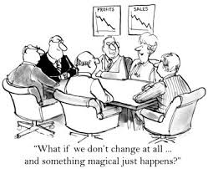
Meaning of Management

Slide 6
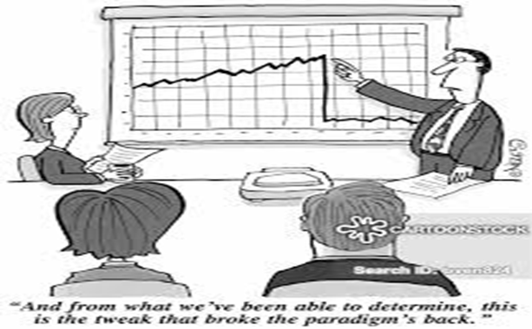

Slide 7
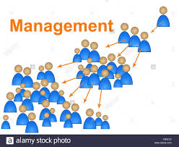

Slide 8
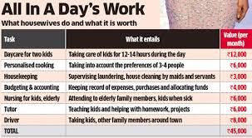
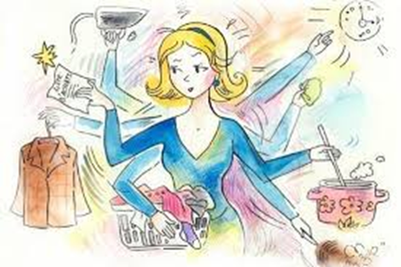
Management, wherever human efforts and desired goals
Lets have an example of a homemaker ,how she uses the managerial ingredients in managing home.

Slide 9
Appraisal of households and its needs
Forecast the needs (week/month/year)
Takes of available resources and any constraints
Plan and organizes resources for maximum benefits
Monitors and controls the households budget and expenses
Divides work among the other members and coordinates the things
Encourages and motivates
Search for improvements in goals

Slide 10
The concept of management is as old as the human race itself. (access of food, safety of family, planning of hunting, organizing groups etc.) there are good examples of good orgaizational structures. (a village open market in a tribe /large dept store serve the same needs in a similar fashion in both simple and modern way) Even the recorded history shows the appications of some current management techniques. ( 5000BC, early civilization of India

Slide 11
Management as a system (life/organization) (well managed life is much better organized goal oriented and successful “good” management of an organization makes the difference between the success and the failure) Management and renowned personalities like US President Kennedy and management authority Peter Drucker as ,” effective management was becoming the main resource of developed nations and that it was the most needed resource for developing nations

Slide 12
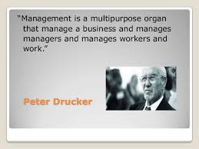
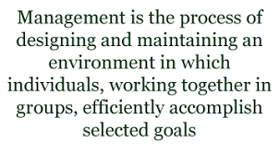
Definitions of Management

Slide 13
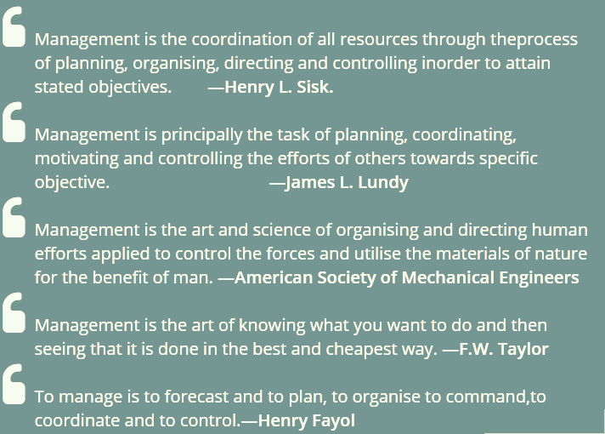

Slide 14
Components of Management
Human resources
Physical resources
Managerial activities
Effective and efficient utilization
goals
Financial resources
Informational resources

Slide 15
P
O
D
C
Physical
Financial
Human
Information
Management
GOALS

Slide 16
Integral elements of this definitions are------ Problem Solving Process Organizational Objectives Efficiency Scarce Resources Changing Environment

Slide 17
Effectiveness versus Efficiency 1. For management, it is important to be both effective and efficient. 2. it is easier to be effective and ignore efficiency .

Slide 18
a company’s target production is 5000 units in a year. To achieve this target the manager has to operate on double shifts due to power failure most of the time. The manager is able to produce 5000 units but at a higher production cost. In this case,the manager was effective but not so efficient, since for the same output, more inputs (labour cost, electricity costs) were used.

Slide 19
a business may concentrate more on producing goods with fewer resources i.e., cutting down cost but not achieving the target production. Consequently, the goods do not reach the market and hence the demand for them declines and competitors enter the market. This is a case of being efficient but not effective since the goods did not reach the market. Therefore, it is important for management to achieve goals (effectiveness) with minimum resources

Slide 20
Objectives of Management:
(i) Organisational Objectives: (ii) Social objectives: (iii) Personal objectives:

Slide 21
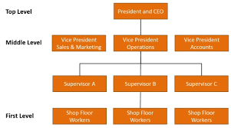
Levels of Management:
Top Management: (ii) Middle Management: (iii) Supervisory or Operational Management:

Slide 22
Functions of Management

Slide 23
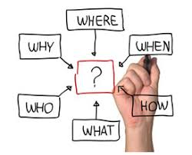
Planning:

Slide 24
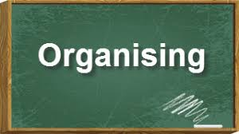
Organising :

Slide 25
Directing :

Slide 26
Controlling:

Slide 27
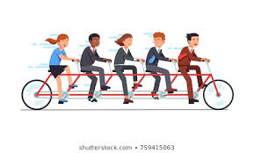
Coordination:

Slide 28
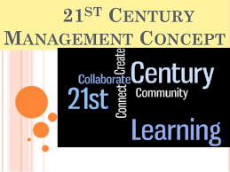
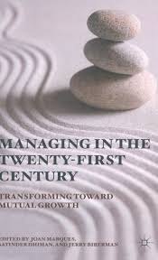
Management in the Twenty-first Century

Slide 29
REFERENCES
https://www.lpcentre.com/articles/10-business-management-principles-every-entrepreneur-must-know
https://www.lpcentre.com/articles/10-business-management-principles-every-entrepreneur-must-know

Slide 30
THANK YOU!

