Slide 1
Vivekanand College, Kolhapur(Autonomous)
Department of Commerce
B.COM-I_SEM-II

Slide 2
Insurance paper –II
by
Dr. Revati Patil

Slide 3
MODULE – I Content
Life Insurance:
Introduction to Life Insurance.
Meaning & Nature of Life Insurance.
Significance of Life Insurance.
Procedure of Taking Life Insurance Policy.
Life Insurance Products-
Whole Life
Endowment
Term Plans
Pension & Annuity Plans
Settlement Of Claims.
LIC of India -Role &Functions.
Major Players In Life Insurance In India.

Slide 4
Introduction to Life Insurance.
What Is Life Insurance?
Life insurance can be termed as an agreement between the policy owner and the insurer, where the insurer for a consideration agrees to pay a sum of money upon the occurrence of the insured individual’s death or other event, such as terminal illness, critical illness or maturity of the policy.

Slide 6
History of Life Insurance
Insurance in India can be traced back to the Vedas for instance Yogakshema , the name of Life Insurance Corporation of India’s corporate headquarter, is derived from the Rig Veda.
Bombay Mutual Assurance Society, the first Indian Life Assurance Society, was formed in 1870.
Other companies like Oriental, Bharat And Empire of India were also set up in the 1870-90s.

Slide 7
Contd….
It was during the Swadeshi Movement in the early 20th century that insurance witnessed a big boom in India with several more companies being set up.
By the mid -1950s, there were around 170 insurance companies and so provident fund societies in the country’s life insurance scene. However in the absence of regulatory framework. Scams and irregularities were prevalent in most of these companies.

Slide 8
Contd….
As a result, the government decided to nationalize the life assurance business in India. The Life Insurance Corporation of India was set up in 1956 to take over around 250 life insurance companies.
For years thereafter insurance remained a monopoly of the public sector. The sector was finally opened up to private players in 2001.

Slide 9
Contd….
The IRDA, an assurance autonomous insurance regulator set up in 2000, has extensive powers to oversee the insurance business and regulate in a manner that will safeguard the interest of the insured.

Slide 10
Why to have a Life Insurance?
Protection (security)
Liquidity (investment/ saving)
Tax Relief
Money when to need it (collateral for loans/old age pension)

Slide 11
Why Insurance Sector Is Privatized?
To give individual & corporate consumers a competitive environment that can deliver products & services in tune with their requirements.
Industry to benefit from technology transfer & capital from global insurance players.
India is a signatory to WTO committed to open insurance & banking.

Slide 12
5 ‘R’s of Insurance
Risk
Return
Riders
Rewards Value Add
Rebate

Slide 13
Insurance
Is
Fortunate Many
For
Unfortunate
Few

Slide 14
Classification Chart
INSURANCE
GENERAL INSURANCE
LIFE INSURANCE
HEALTH INSURANCE
MOTOR INSURANCE
MARINE INSURANCE
FIRE INSURANCE

Slide 15
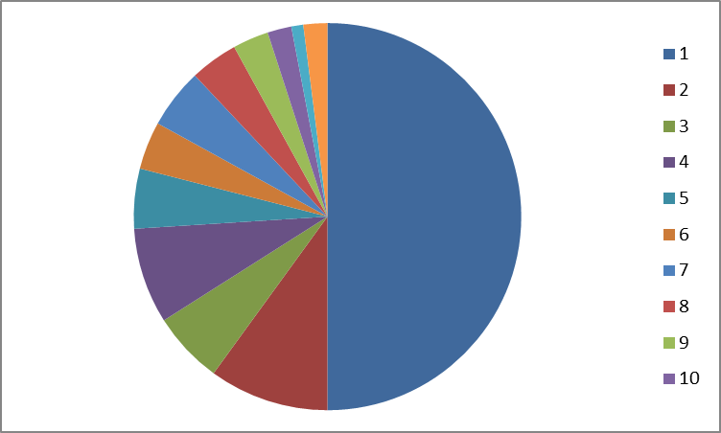
Life Insurance: Market Share 2010-11
LIC
ICICI
HDFC
OTHERS
SBI
BAJAJ
RELIANCE
BIRLA
MAX
TATA
MET
KOTAK
50%
10%
6%
8%
5%
4%
5%
4%
3%
2%
1%
2%

Slide 16
