Slide 1
SEMESTER I
PRINCIPLES OF BUSINESS MANAGEMENT
TOTAL MARKS : 50 (35+15)
INTERNALS: FIELD WORK (15)

Slide 2
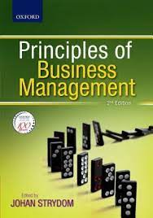

Slide 3
MODULE I
Introduction to Management:
Introduction
Concept Effectiveness And Efficiency
Nature Of Management
Characteristics Of Management
Objectives Of Management
Importance Of Management
Management As An Art
Management As A Science
Management As A Profession
Management And Administration
Levels Of Management
Coordination — The Essence of Management, Characteristics of Coordination, Importance of Coordination

Slide 4
INTRODUCTION
A successful organization (TATA GROUP) which is amongst the top companies in India.
It has secured top position because of its quality of management.
Management is essential for all organizations big or small, profit or non-profit, services or manufacturing. Management is necessary so that individuals make their best contribution towards group objectives.
Management consists of a series of interrelated functions.

Slide 5
Definition
“Management is the process of designing and maintaining an environment in which individuals, working together in groups, efficiently accomplish selected aims.”
Harold Koontz and Heinz Weihrich
“Management is defined as t he process of planning, organising, actuating and controlling an organisation’s operations in order to achieve coordination of the human and material resources essential in the effective and efficient attainment of objectives.”
Robert L. Trewelly and M. Gene Newport

Slide 6
CONCEPT
Different activities in any enterprise.
Diverse tasks towards the same goal
Tasks are completed and goals are achieved (i.e., effectiveness) with the least amount of resources at a minimum cost (i.e., efficiency).
Primary functions are planning, organising, staffing, directing and controlling.

Slide 8
Effectiveness versus Efficiency
Effectiveness
Efficiency
Doing work effectively.
Finishing the right task.
Achieving the goals.
End results.
Efficiency means doing the task correctly and with minimum by using less resources (i.e., the inputs) more benefits are derived (i.e., the outputs)
Cutting down the cost

Slide 10
Cont……..
Therefore, it is important for management to achieve goals (effectiveness) with minimum resources i.e., as efficiently as possible while maintaining a balance between effectiveness and efficiency

Slide 11
Characteristics of Management
Management is goal oriented
The Management Mantra from GE
Create a vision and then ignite y organisation to make vision a reality
Focus on strategic issues.
Focus on the main issue
Involve everyone and welcome great ideas from everywhere.
Lead by example
https://strategyforexecs.com/jack-welch-ge/

Slide 12
Management is all pervasive / universal applicability.

Slide 13
Management is multidimensional:
Management of work:
Management of people:
Management of operations:

Slide 14
Management is a continuous process:

Slide 15
Management is a group activity:

Slide 16
Management is a dynamic function:

Slide 17
Management is an intangible force

Slide 18
Objectives of Management
Organizational Objectives:
Survival,
Growth,
Profit
https://iocl.com/

Slide 19
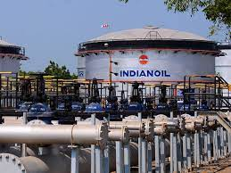

Slide 20
Social Objectives:
ITC – Empowering Rural India
one of India’s largest consumer product and agribusiness companies. ITC’s E-Chaupal initiative

Slide 21
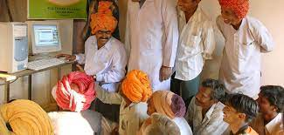

Slide 22
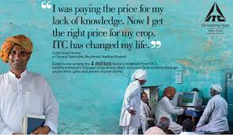

Slide 23
Personnel Objectives:
different personalities, backgrounds, experiences and objectives and their diverse needs.

Slide 24
Importance of Management
Management helps in achieving group goals:
Management increases efficiency:
Management creates a dynamic organisation:
Management helps in achieving personal objectives:
Management helps in the development of society:

Slide 25
Nature of Management
Management is as old as civilisation.
Industrial Revolution
The development of trade and commerce gradually led to the development of management principles and practices

Slide 27
Management as an Art
Existence of theoretical knowledge:
For example, literature on dancing, public speaking, acting or music is widely recognised.
Personalised application:
For example, two dancers, two speakers, two actors, or two writers will always differ in demonstrating their art.
Based on practice and creativity:
The best managers are committed and dedicated individuals; highly trained and educated, with personal qualities such as ambition, self motivation, creativity and imagination, a desire for development of the self and the organisation they belong to.

Slide 29
Management as a Science
i) Systematised body of knowledge: Science is a systematic body of knowledge. Its principles are based on a cause and effect relationship. For example, the phenomenon of an apple falling from a tree towards the ground is explained by the law of gravity.
(ii) Principles based on experimentation: Scientific principles are first developed through observation and then tested through repeated experimentation under controlled conditions. (iii) Universal validity: Scientific principles have universal validity and application

Slide 31
Management as a Profession
specific qualifications and experience
Does this imply that management is a profession?
Well-defined body of knowledge: own theory and principles
Restricted entry: specific degree
Professional association:
AIMA
Ethical code of conduct: statutary backing
Service motive:
efficient and effective it automatically serves society by providing good quality products at reasonable prices

Slide 33
Levels of Management

Slide 36
Coordination
— The Essence of Management
Characteristics of Coordination
Importance of Coordination
Example: ‘MUMBAI DABBAWALLAS’ – Excellence through Coordination

Slide 37
REFERENCES

