Slide 1
VIVEKANAND COLLEGE KOLHAPUR,(AUTONOMOUS)
Department of Commerce
Dr. . Revati Patil
Business Management-I

Slide 2
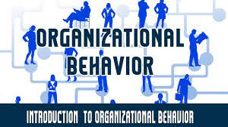

Slide 3
Module I
Introduction to Organizational Behaviour
Introduction to Organizational Behaviour:
Concept, Significance, Nature And Scope Of OB
Contributing Disciplines To OB
Relationship Between Management and Organizational Behaviour
Ethical Issues In OB
Historical Development of OB
Models of OB.

Slide 4



Slide 5
Organizational Behaviour (OB)
Study of human behaviour at work
Complex business world– risks /uncertainities/global environment

Slide 6
Concept of OB
Human beings have emotion, ego, prejudices and feelings.
OB predict and explain the behaviour of individuals and group at work.

Slide 7
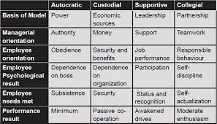

Slide 8
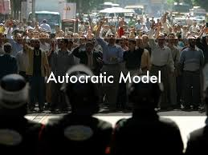

Slide 9
The Autocratic Model
Might is right” is the motto of the theory. It depends upon power. Those who are in command must have power to demand. Employees are to follow their boss. Management thinks that employees are passive and resistant to organisational needs. It is just like theory developed by McGregor. Under autocratic conditions the employee orientation is obedience to a boss, not respect for a manager. The psychological result for employee’s orientation is dependence on their boss, whose power to hire, fire, etc., is almost absolute. The boss pays minimum wages because minimum performance is given by employees. They are willing to give minimum performance though sometimes reluctantly because they must satisfy subsistence needs for themselves and their families.

Slide 10
The autocratic model has existed for thousands of years. During the Industrial Revolution, it was the prominent model of organisational function. The managers of this type of organisation operate mostly out of Mc Gregor’s Theory X. As you might recall, this philosophy of management assumes that people are inherently lazy, dislike work, and will avoid work if they can. As a result, management needs to closely supervise workers and develop comprehensive systems of control. Beliefs of this theory lead to mistrust, highly restrictive supervision, and a punitive atmosphere

Slide 11
The model depends on power with a managerial orientation of authority- those who are in power act autocratically. The message to employees is- ‘You do this, or else’, meaning that employees who do not follow orders are penalised, often severely. In an autocratic environment the managerial orientation is formal, official authority. This authority is delegated by right of command over the people to it applies. The employees in turn are oriented towards obedience to a boss, not respect for a manager. The psychological result for employees is dependence on their boss, whose power to hire, fire, and “perspire” them is almost absolute.

Slide 12
The employee need that is met is subsistence (for themselves and their families). The boss pays minimum wages because minimum performance is given by employees. Some employees give higher performance because of an internal achievement drive, because they personally like the boss, because the boss is a natural leader, or because of some other situational factor; but most of them give only minimal performance. When an autocratic model of organisational behaviour exists, the measure of an employee’s morale is usually his compliance with rules and orders. Compliance is “unprotesting assent without enthusiasm” (Hicks, 1971, p. 186). The compliant employee takes his orders and does not talk back.

Slide 13
The autocratic model uses one way downward communication emanating from the top down to the workers. Management believes that it knows best. Employees are obligated to follow orders. Management does the thinking; employees have to obey the directives. Under such conditions, the “worker’s role is obedience to management” (Zastrow, 2009, p. 26

Slide 14
Although modern writers have an inherent tendency to condemn this model, it is actually very effective in some settings, for instance it works well especially in times of an organisational crisis. Military organisations throughout the world are based on this model. This view of work built great railroad systems, operated 50 Organisational Psychology giant steel mills, and produced the spectacular industrial civilisation in the United States. It, however, also has a number of disadvantages. Workers are often in the best position to identify shortcomings in the structure and technology of the organisational system, but downward communication prevents feedback to management. T

Slide 15
The model fails to generate commitment among workers to accomplish organisational goals. Lastly, the model fails to motivate workers to further develop their skills- skills that might even help the employer. It often has disturbing side effects- employees feel insecure, frustrated, and may even have feelings of aggression towards the management. Since employees could not vent these feelings directly, sometimes they vented them on their families, friends and neighbours, leading to the suffering of the entire community

Slide 16
Large commercial organisations have moved away from hierarchical organisations to models where there are relatively autonomous groups of front line staff, supported by the technical staff and management. Control is exercised by the users/consumers and their requirements, translated through information and operational systems that highlight the degree to which consumer demand is being successfully met. The demands of a ‘Just in Time’ system of production, for example, provide the structure and discipline to front line staff formerly supplied by hierarchical managers.

Slide 17
REFERENCES
https://www.amazon.in/Organizational-Behaviour-Pearson-Stephen-Robbins/dp/9353067030

Slide 18
